Slide 1

Page1
Notes:
image
No alt text provided
textbox
No alt text provided
textbox
No alt text provided
image
No alt text provided

Slide 2
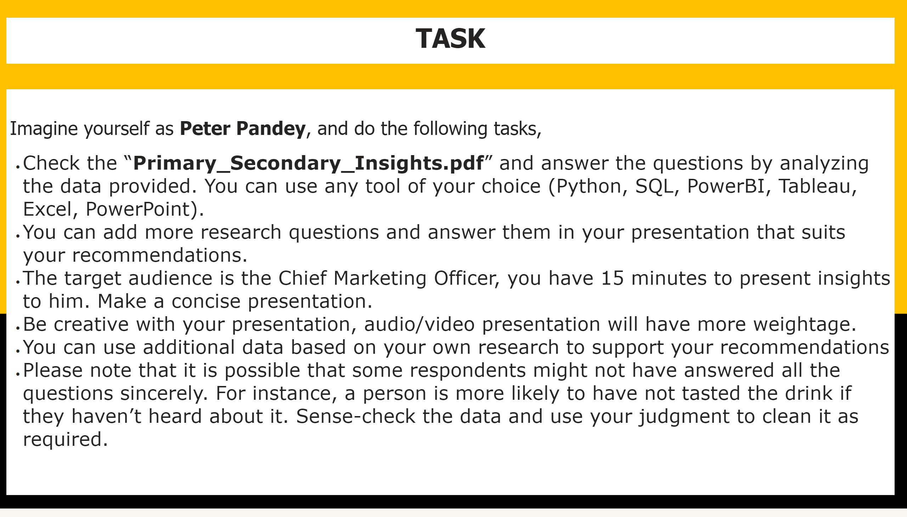
Page 2
Notes:
textbox
No alt text provided
textbox
No alt text provided

Slide 3
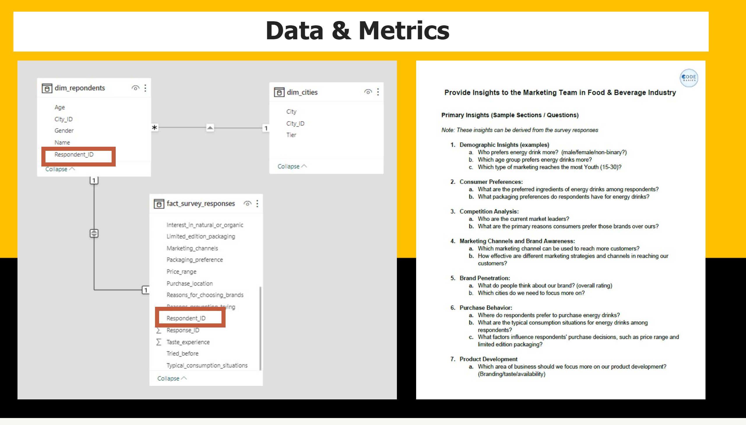
Page 3
Notes:
image
No alt text provided
shape
No alt text provided
shape
No alt text provided
image
No alt text provided
textbox
No alt text provided

Slide 4
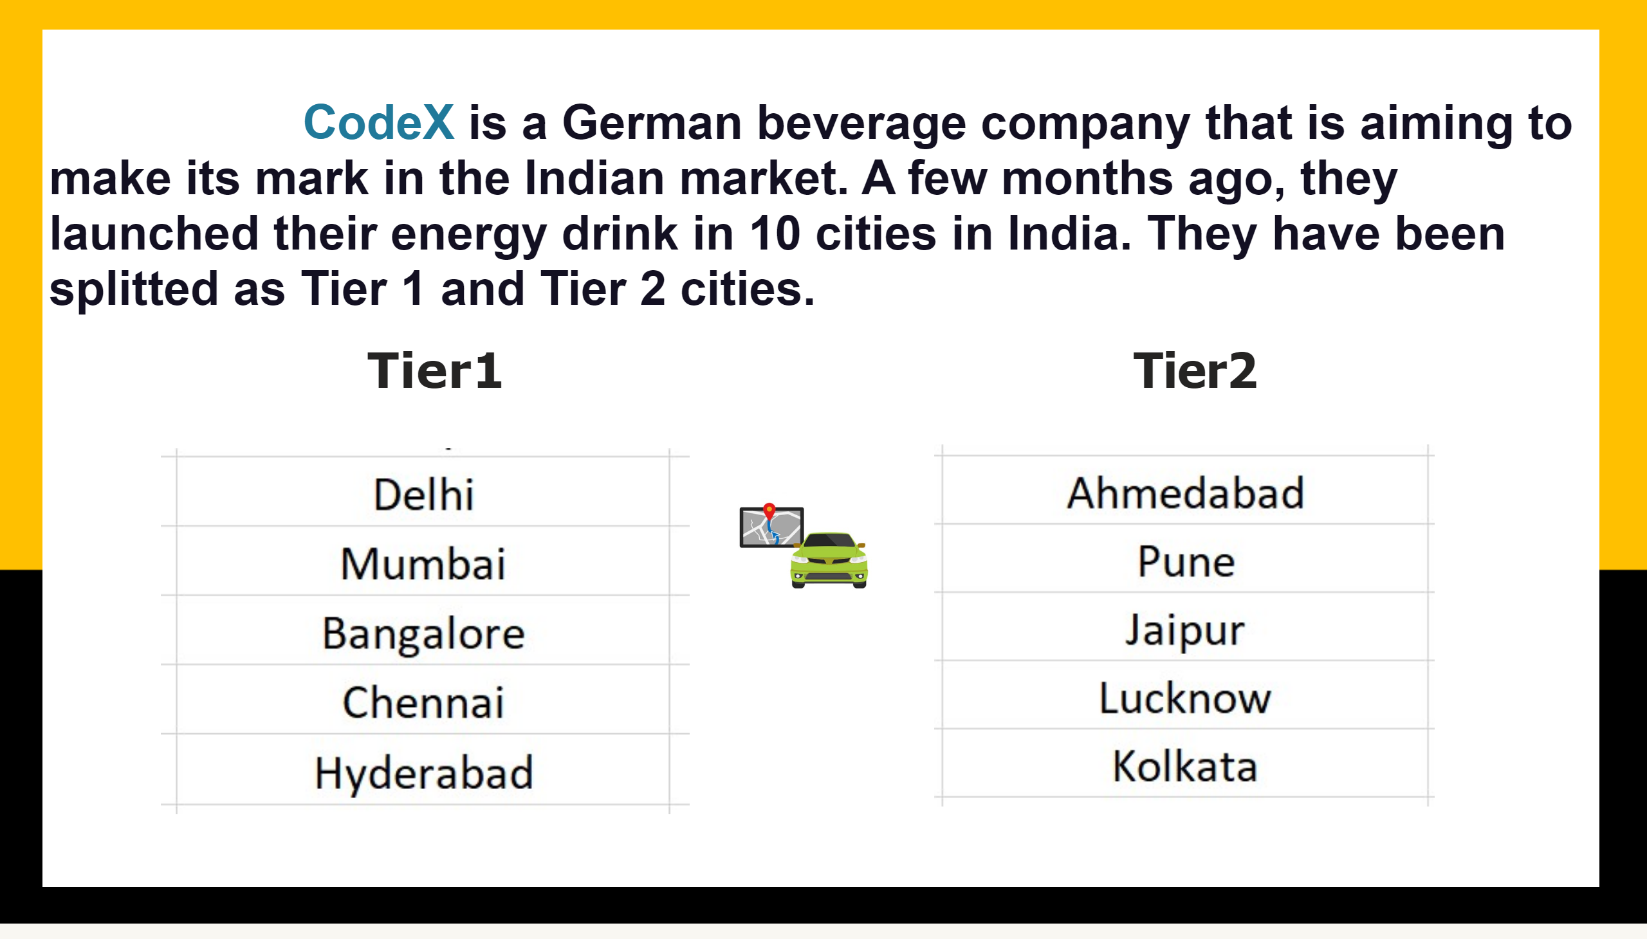
Page4
Notes:
textbox
No alt text provided
image
No alt text provided
image
No alt text provided
textbox
No alt text provided
textbox
No alt text provided
image
No alt text provided

Slide 5
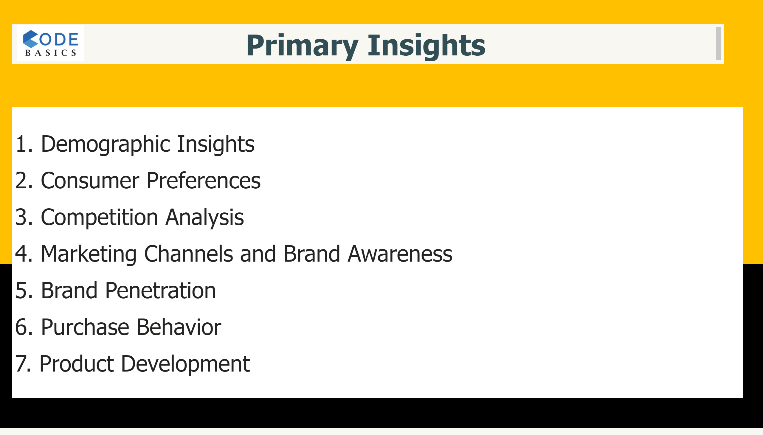
Page5
Notes:
textbox
No alt text provided
textbox
No alt text provided
image
No alt text provided

Slide 6
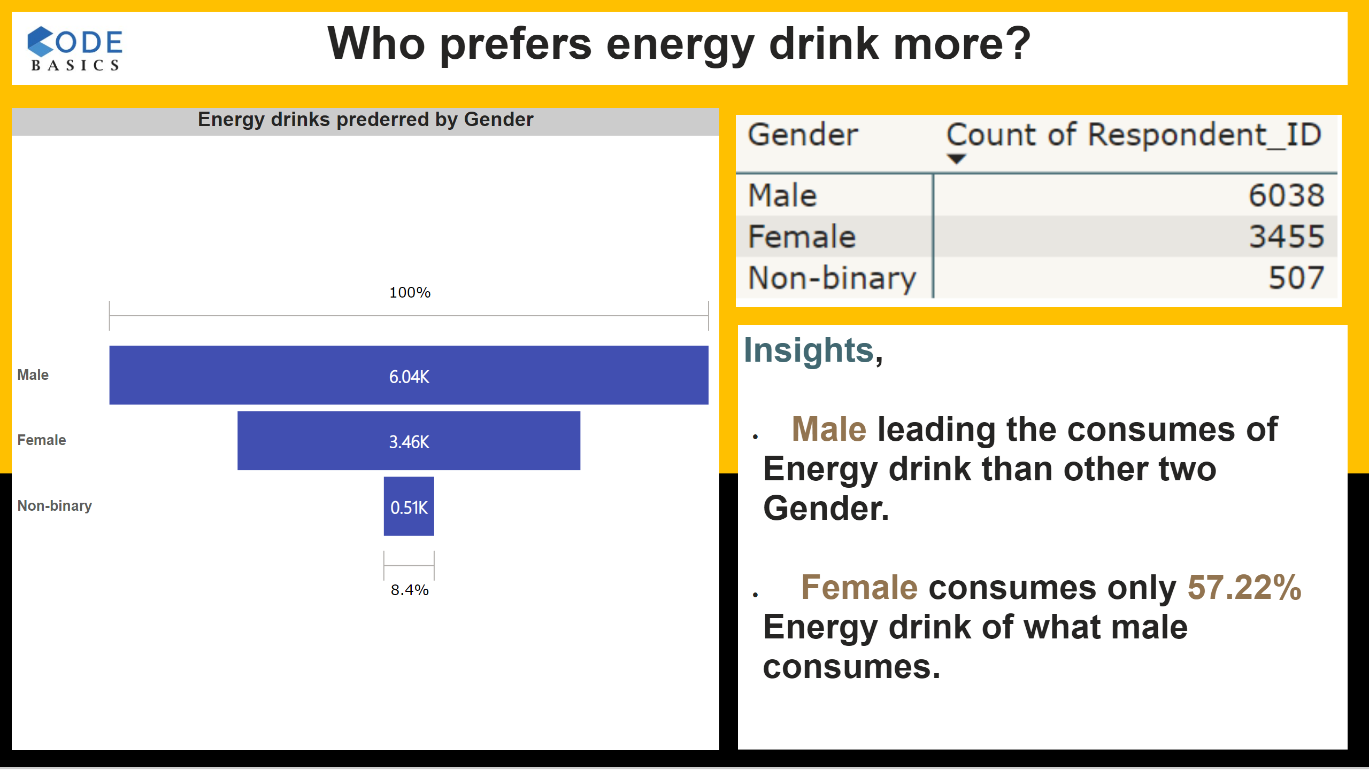
1.1
Notes:
Energy drinks prederred by Gender
No alt text provided
textbox
No alt text provided
textbox
No alt text provided
image
No alt text provided
image
No alt text provided

Slide 7
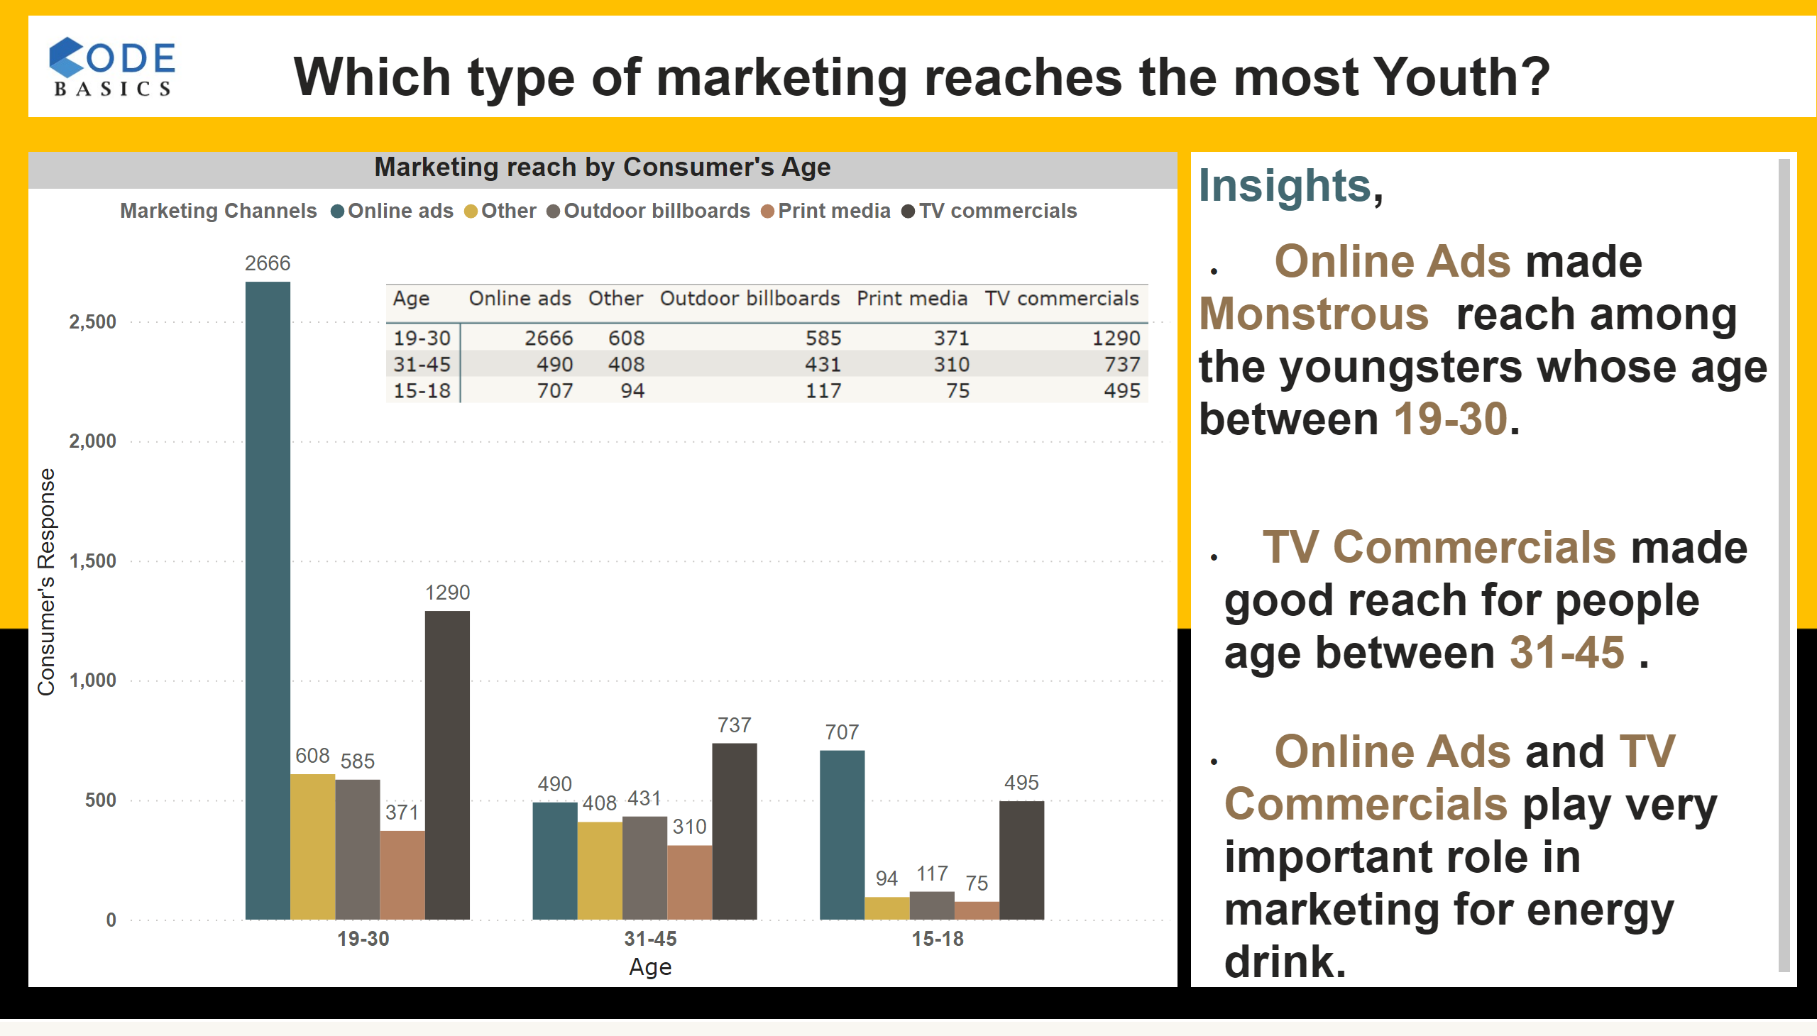
1.2
Notes:
Marketing reach by Consumer's Age
No alt text provided
textbox
No alt text provided
image
No alt text provided
textbox
No alt text provided
image
No alt text provided

Slide 8
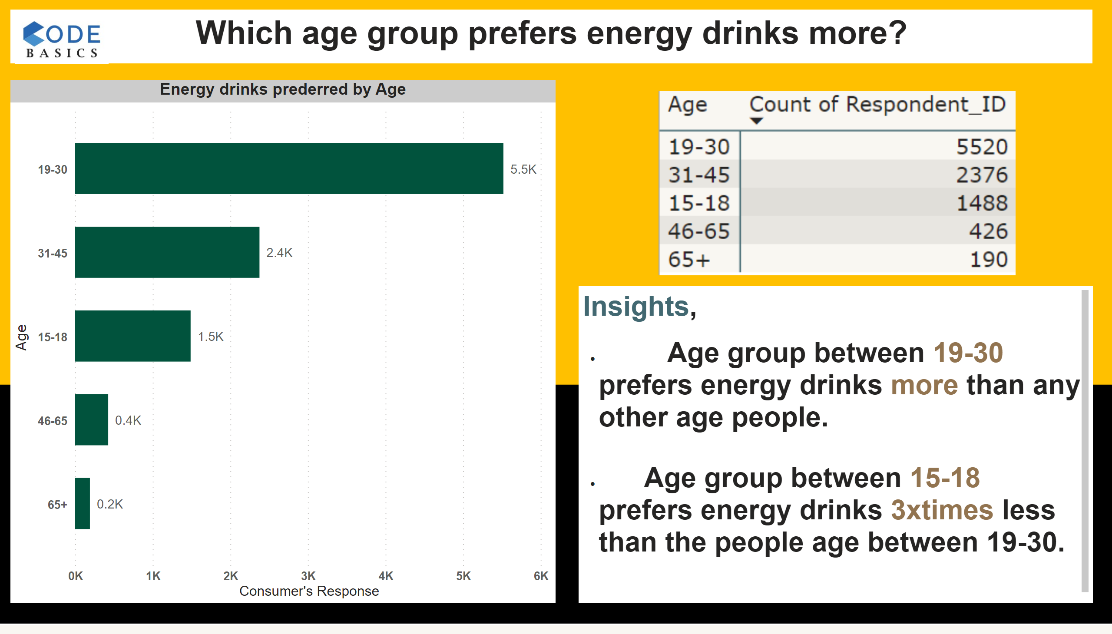
1.3
Notes:
Energy drinks prederred by Age
No alt text provided
textbox
No alt text provided
image
No alt text provided
textbox
No alt text provided
image
No alt text provided

Slide 9
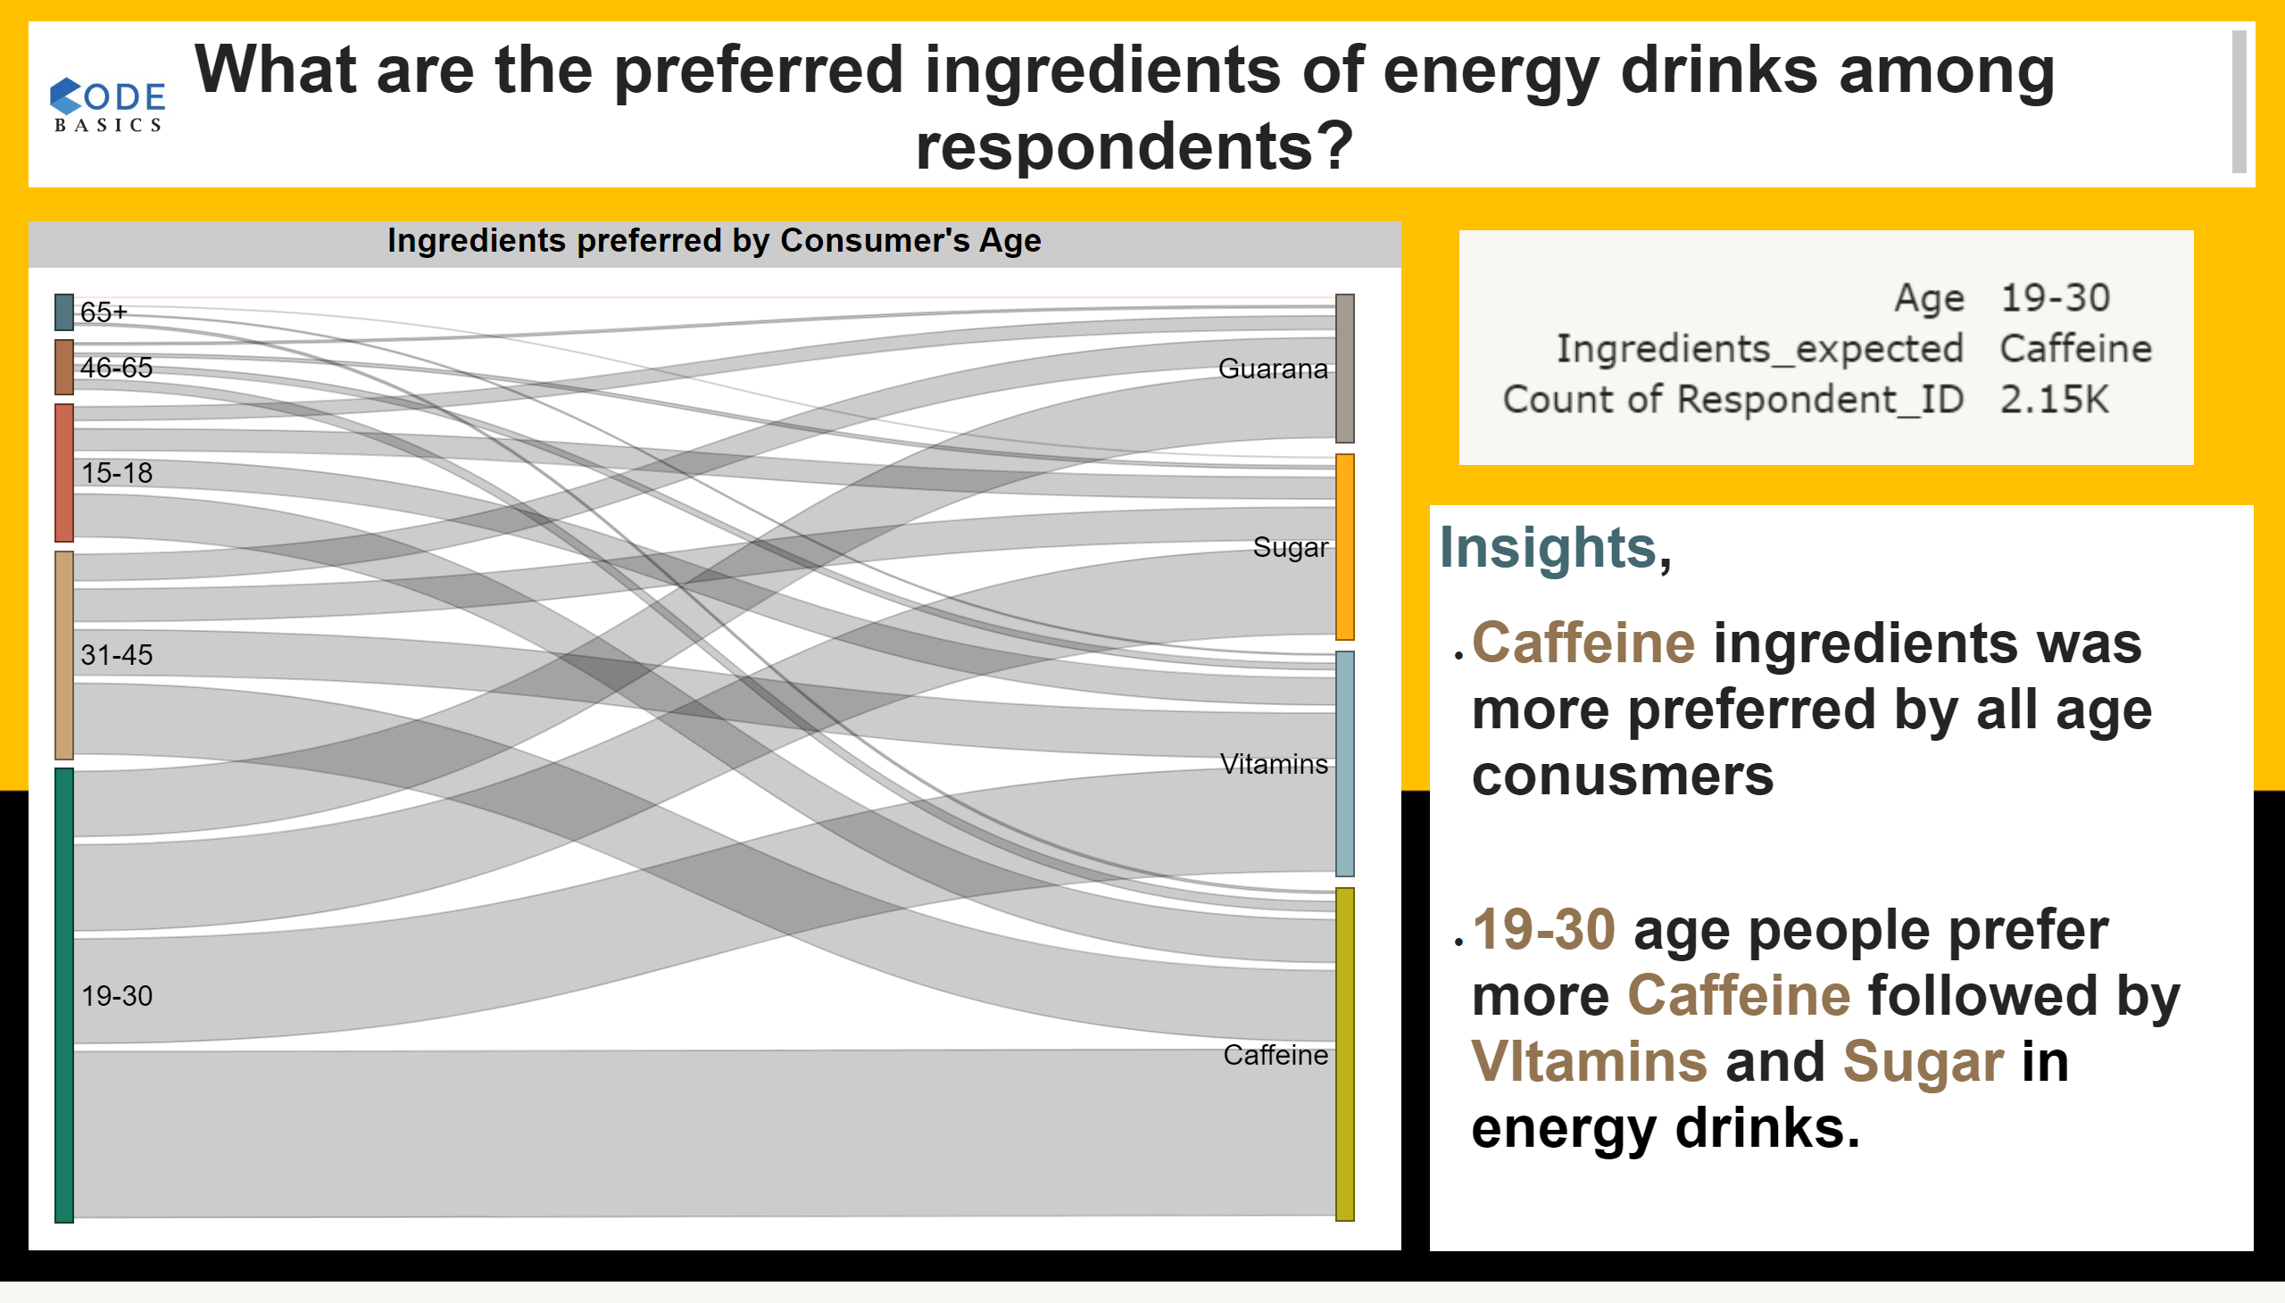
2.1
Notes:
Ingredients preferred by Consumer's Age
No alt text provided
image
No alt text provided
textbox
No alt text provided
textbox
No alt text provided
image
No alt text provided

Slide 10
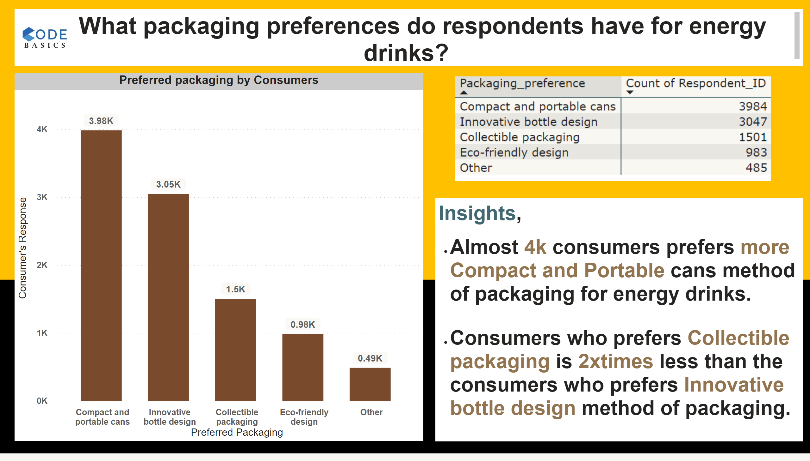
2.2
Notes:
Preferred packaging by Consumers
No alt text provided
image
No alt text provided
textbox
No alt text provided
textbox
No alt text provided
image
No alt text provided

Slide 11
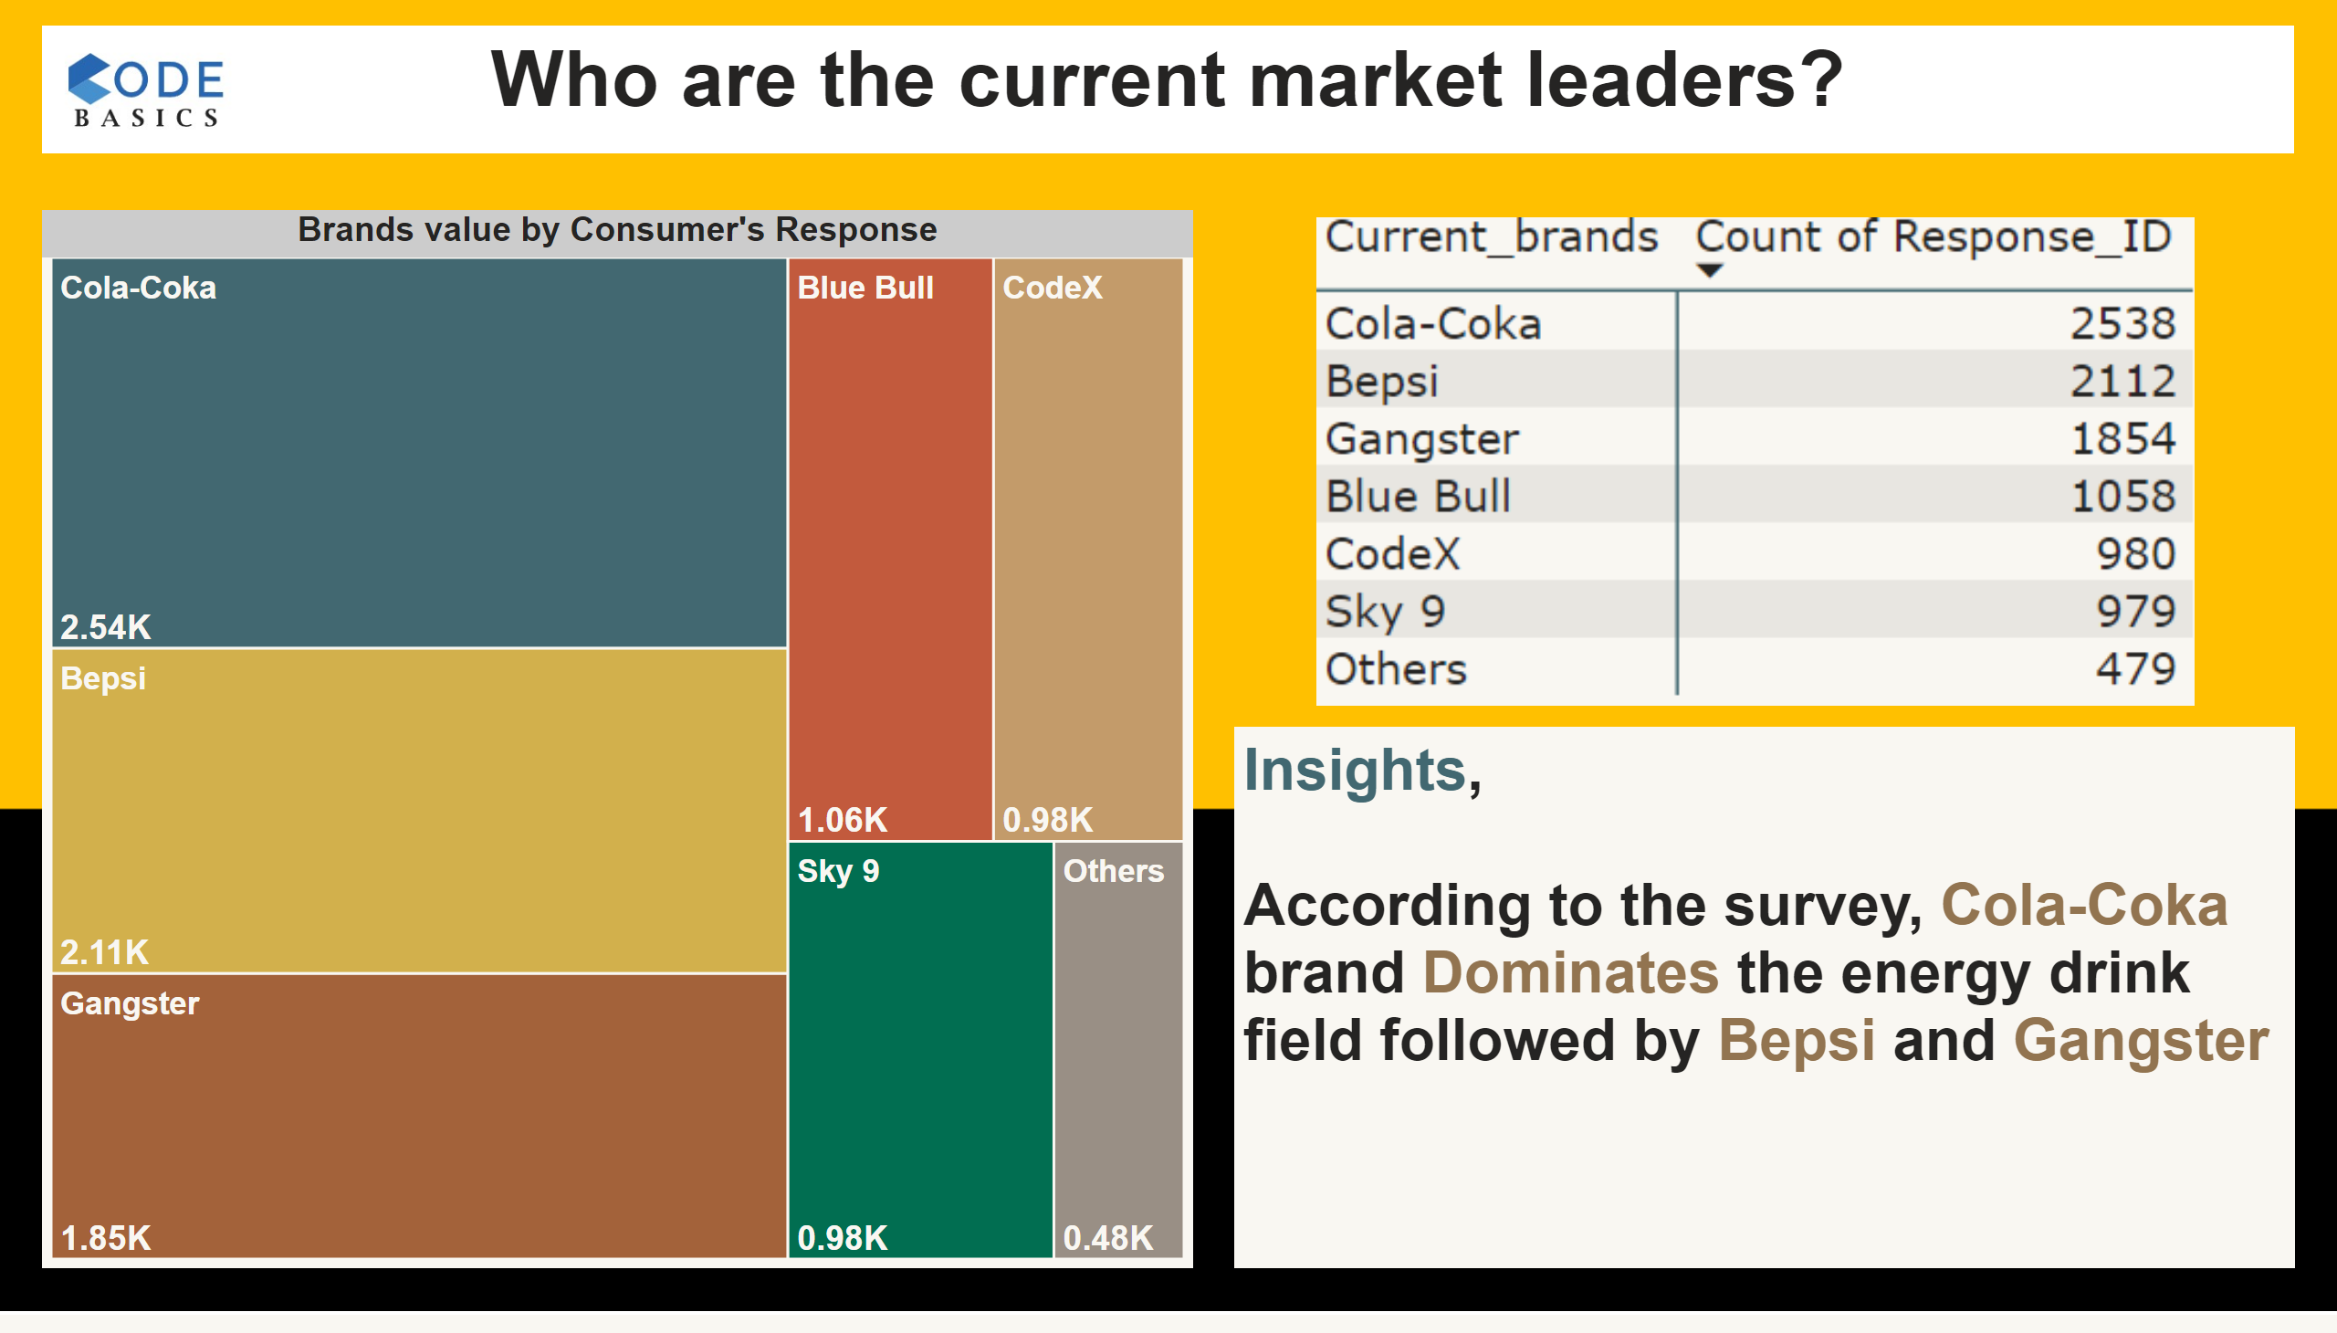
3.1
Notes:
Brands value by Consumer's Response
No alt text provided
image
No alt text provided
textbox
No alt text provided
textbox
No alt text provided
image
No alt text provided

Slide 12
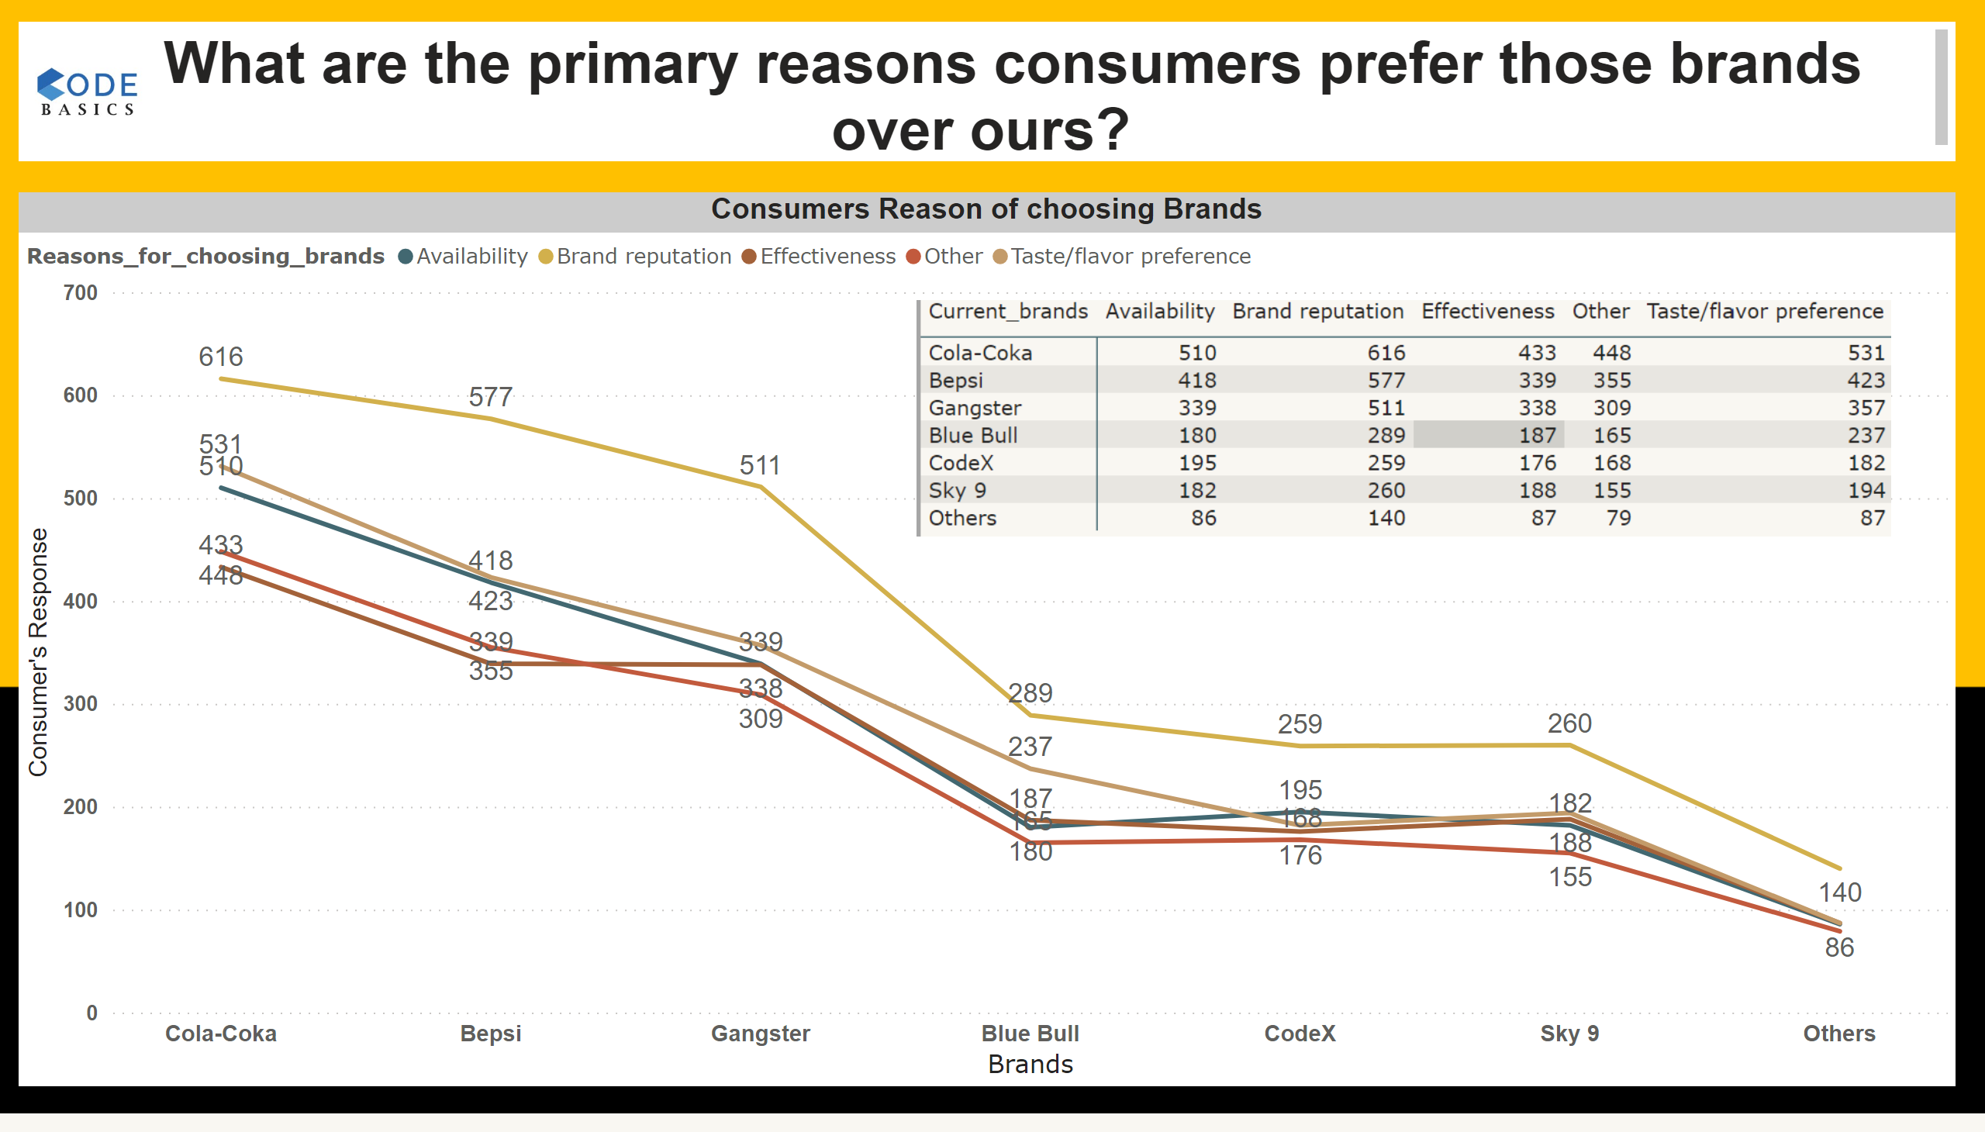
3.2
Notes:
Consumers Reason of choosing Brands
No alt text provided
image
No alt text provided
textbox
No alt text provided
image
No alt text provided

Slide 13
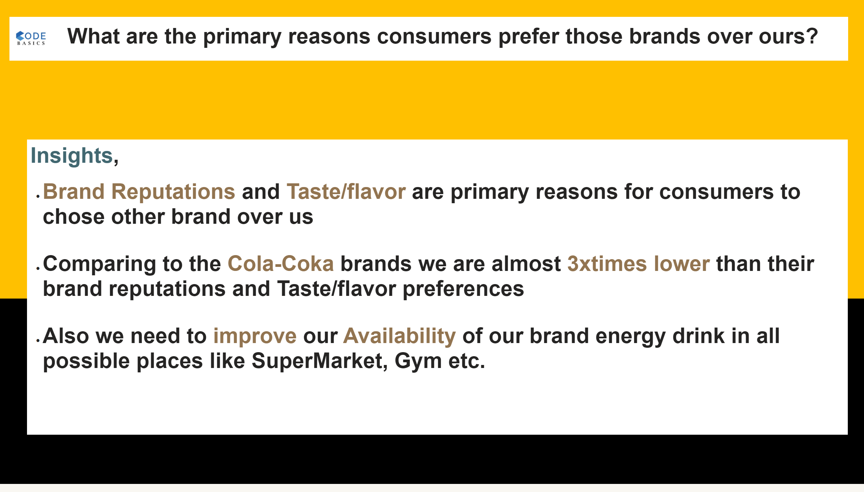
3.3
Notes:
textbox
No alt text provided
textbox
No alt text provided
image
No alt text provided

Slide 14
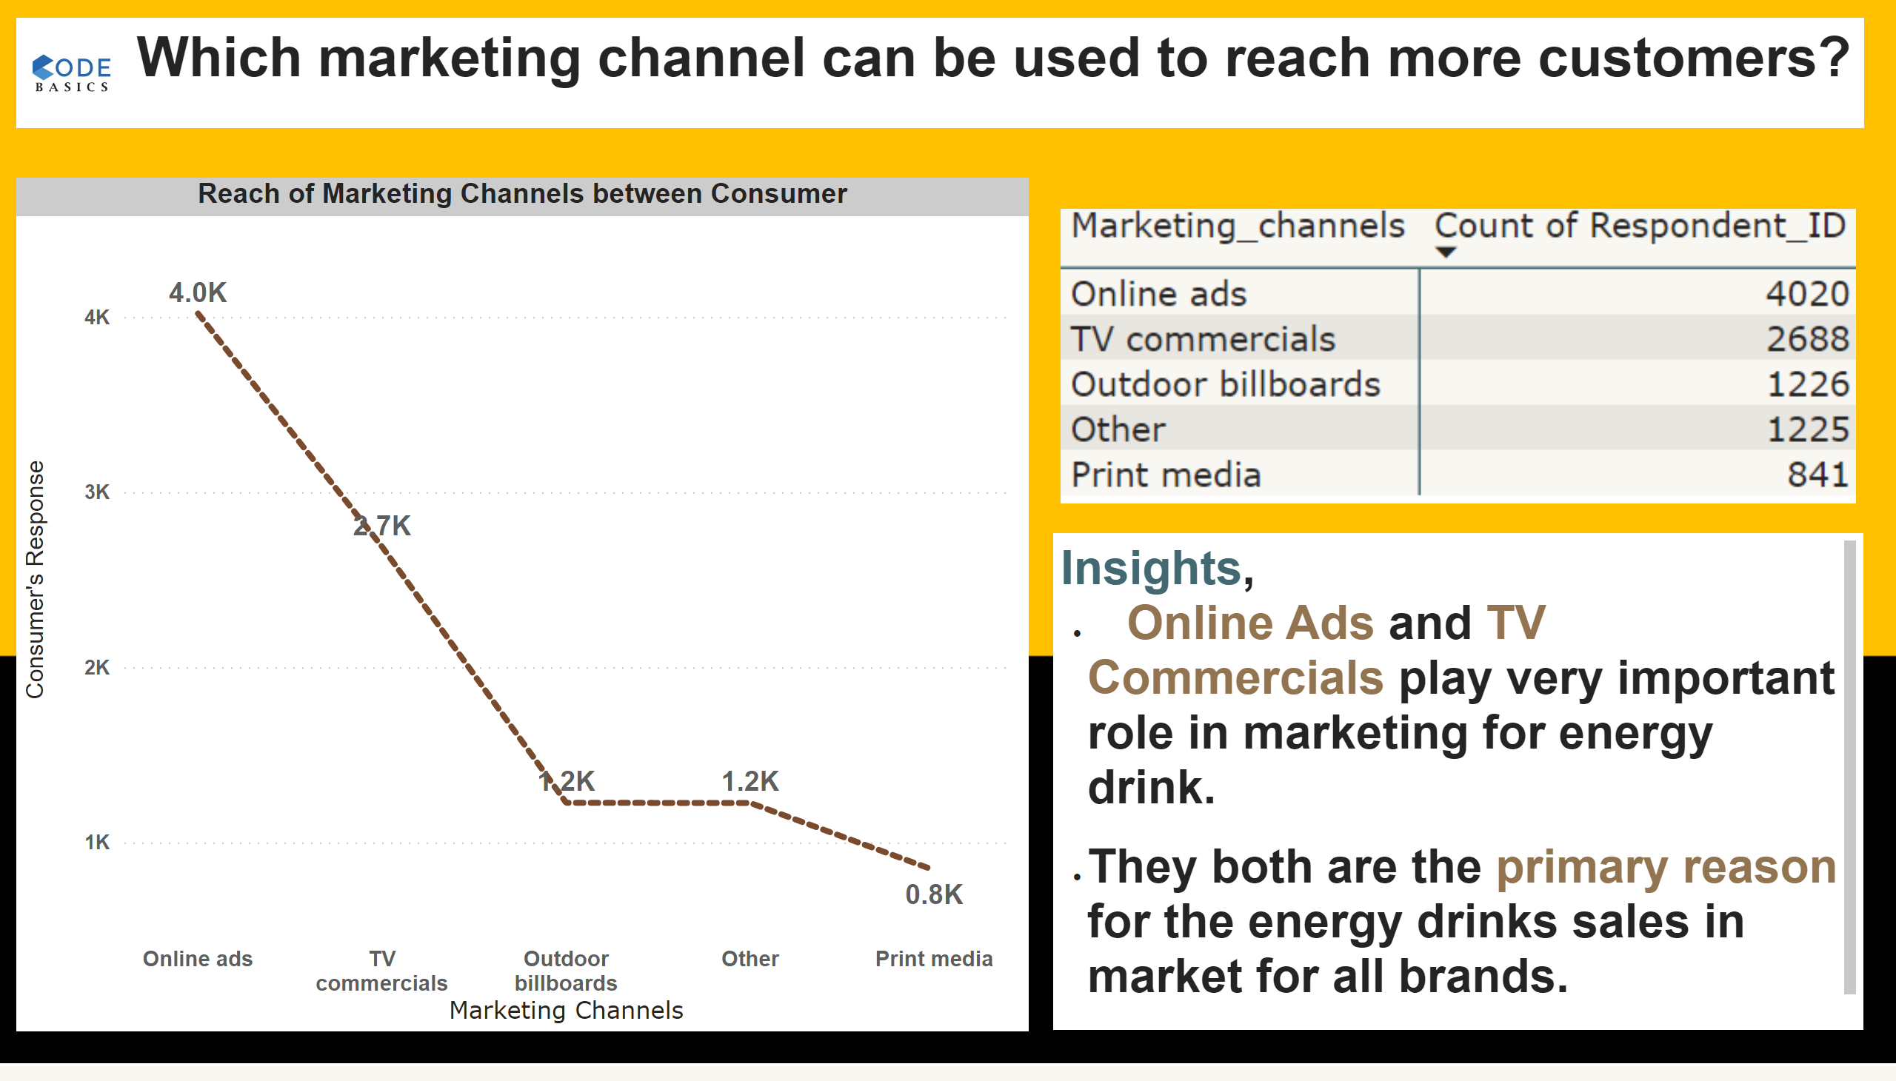
4.1
Notes:
Reach of Marketing Channels between Consumer
No alt text provided
image
No alt text provided
textbox
No alt text provided
textbox
No alt text provided
image
No alt text provided

Slide 15
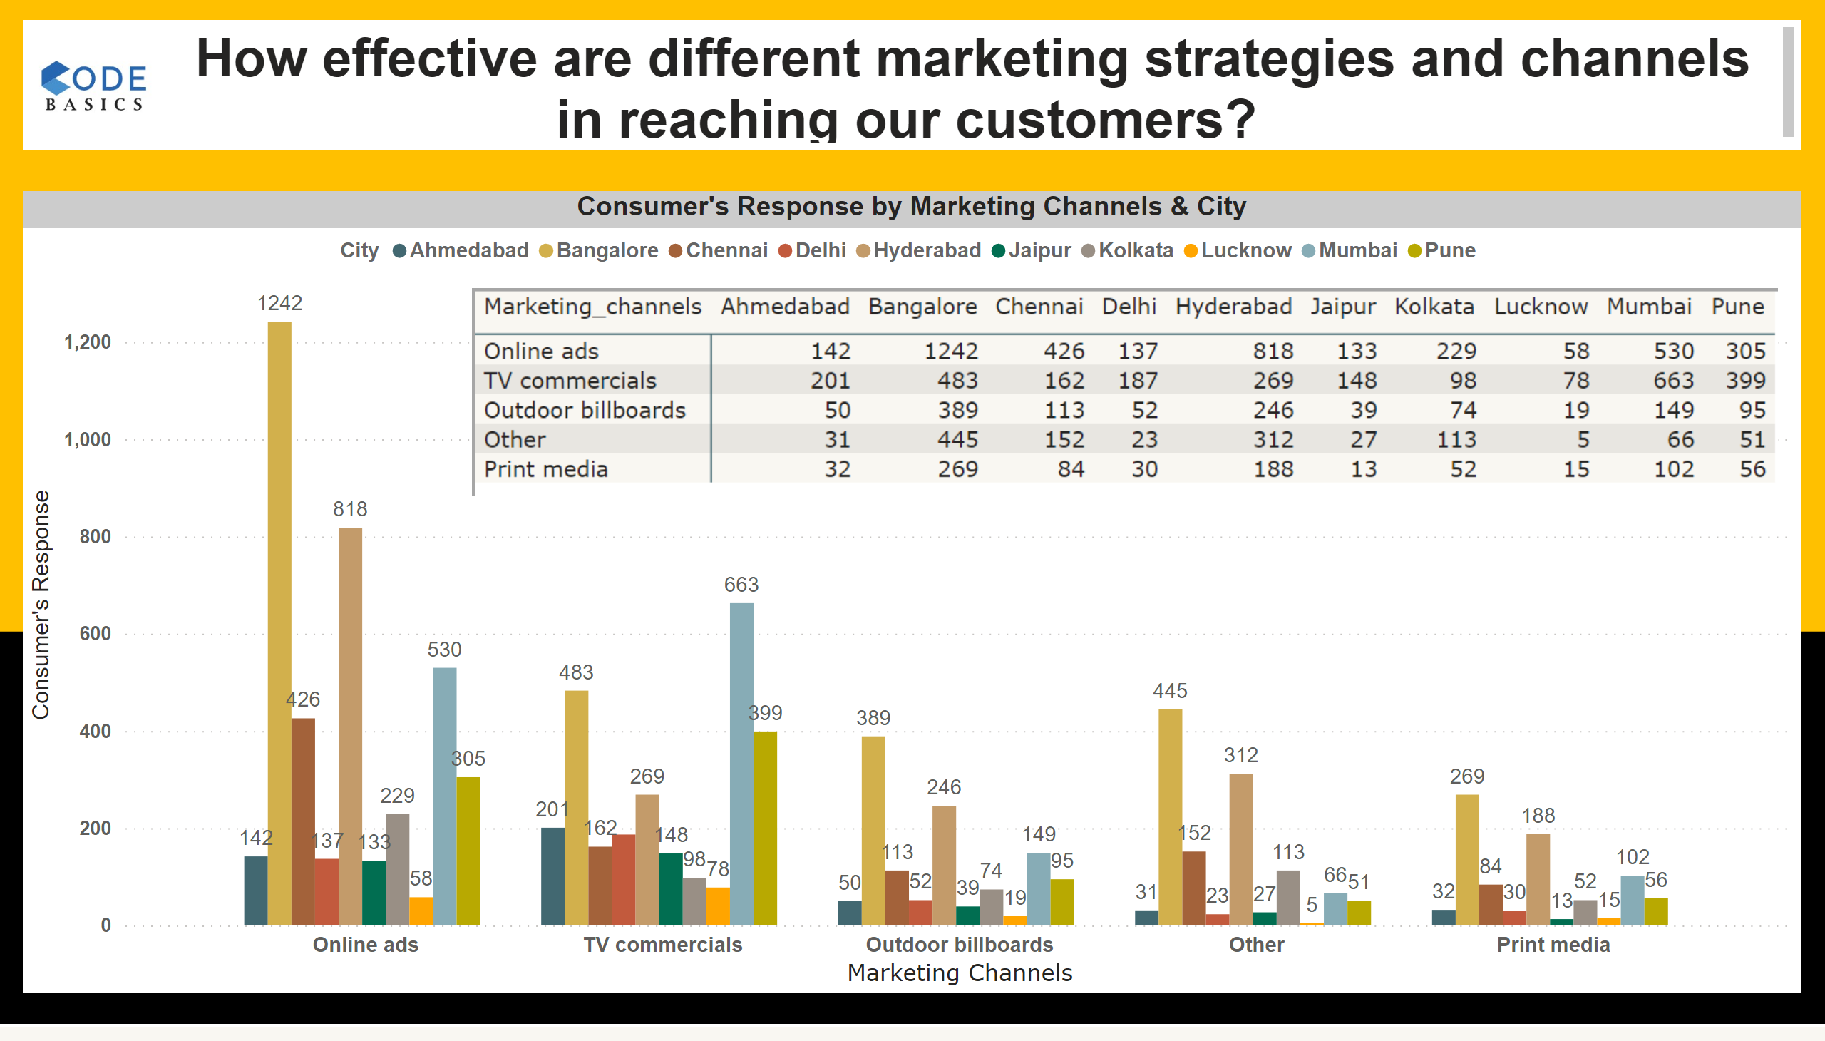
4.2
Notes:
Consumer's Response by Marketing Channels & City
No alt text provided
image
No alt text provided
textbox
No alt text provided
image
No alt text provided

Slide 16
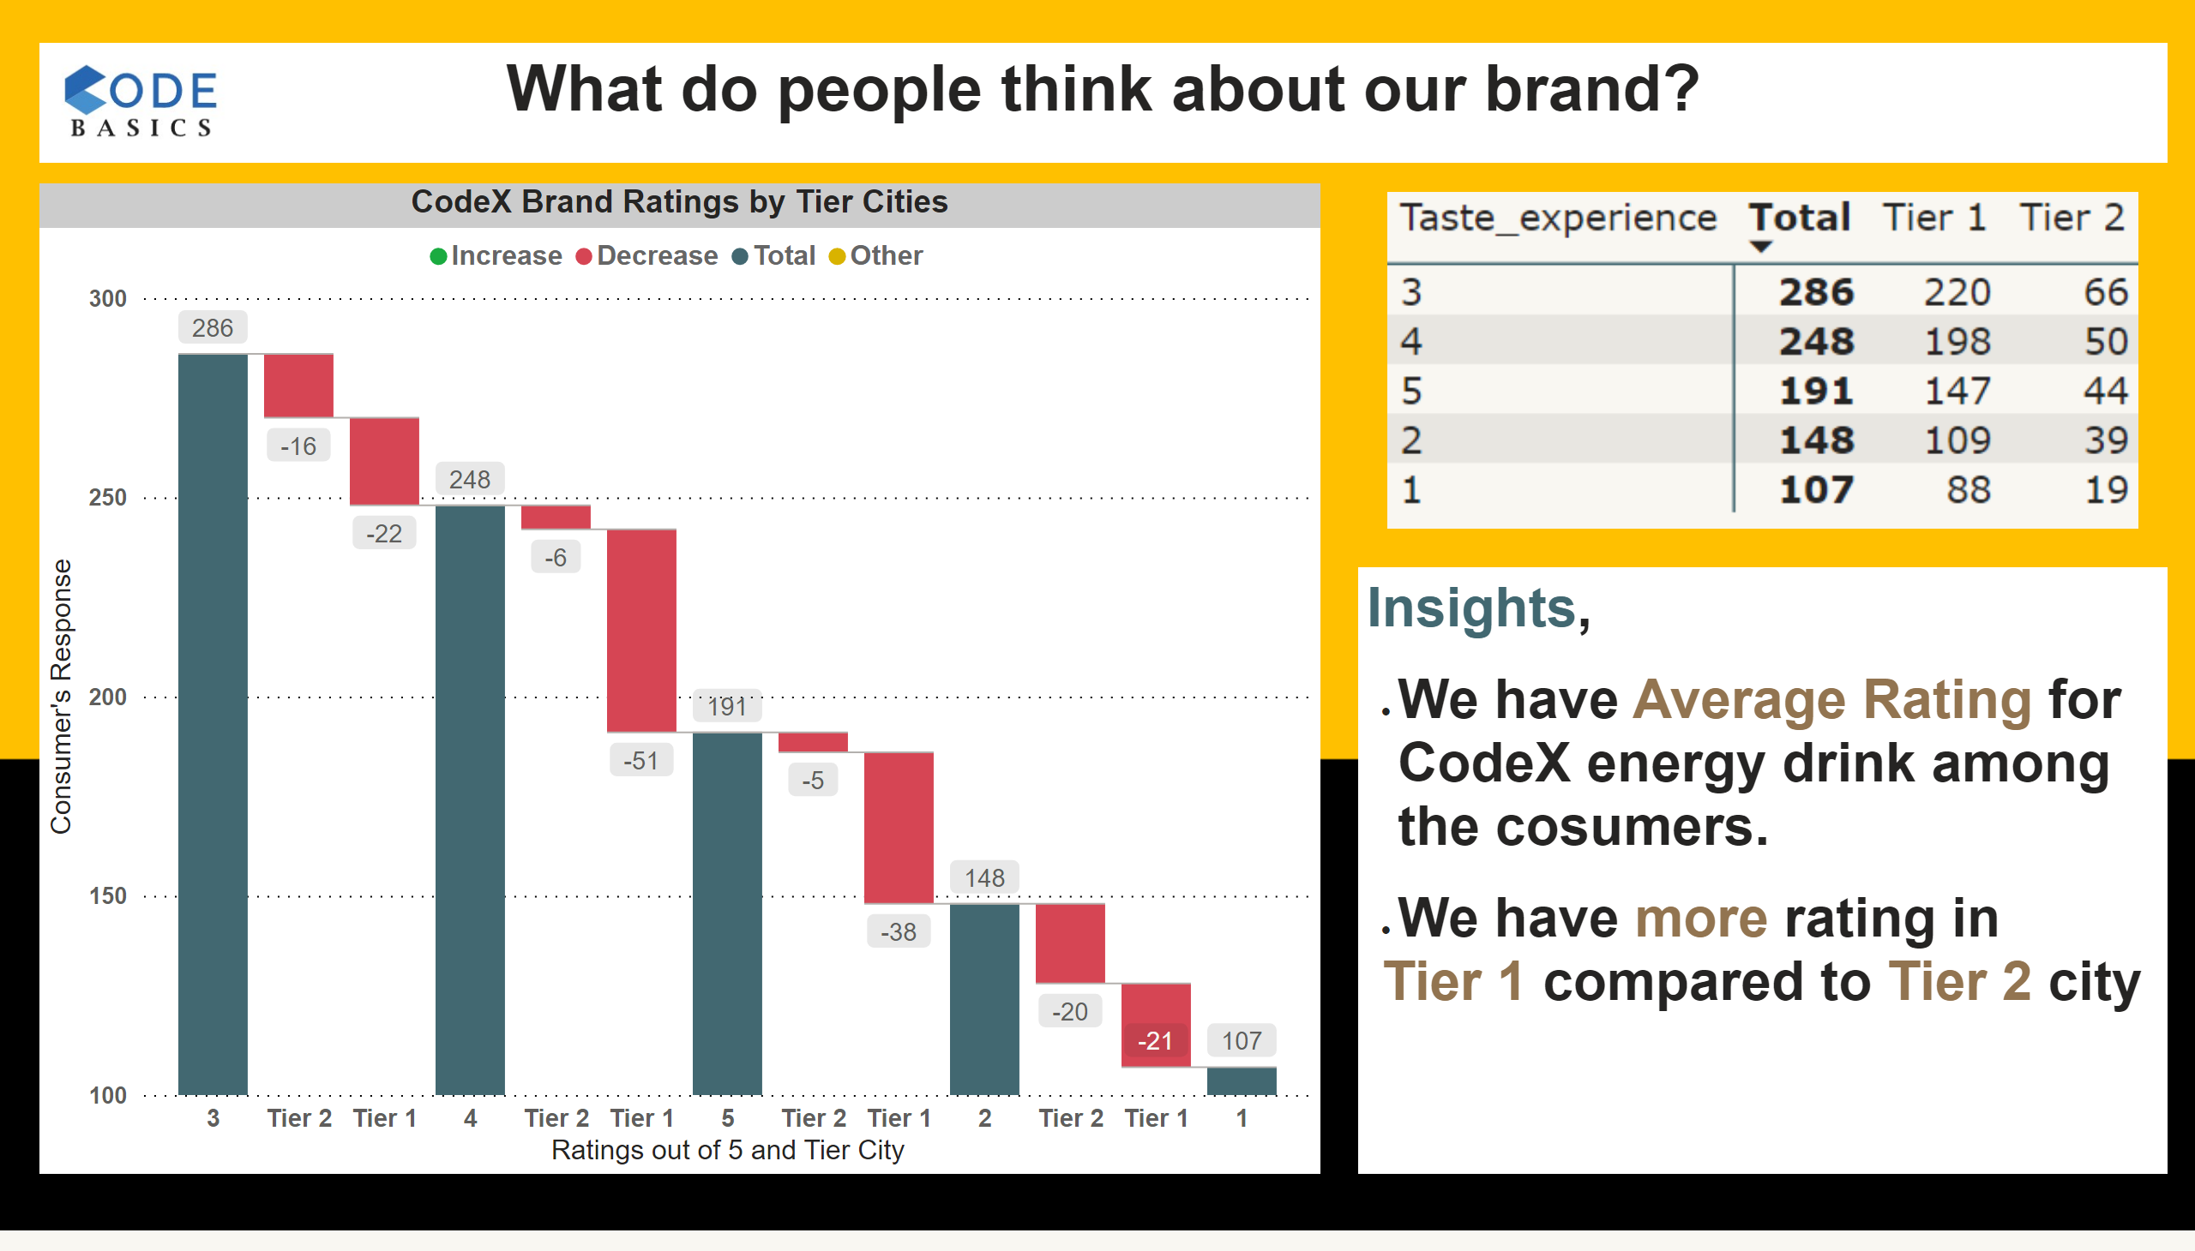
5.1
Notes:
CodeX Brand Ratings by Tier Cities
No alt text provided
image
No alt text provided
textbox
No alt text provided
textbox
No alt text provided
image
No alt text provided

Slide 17
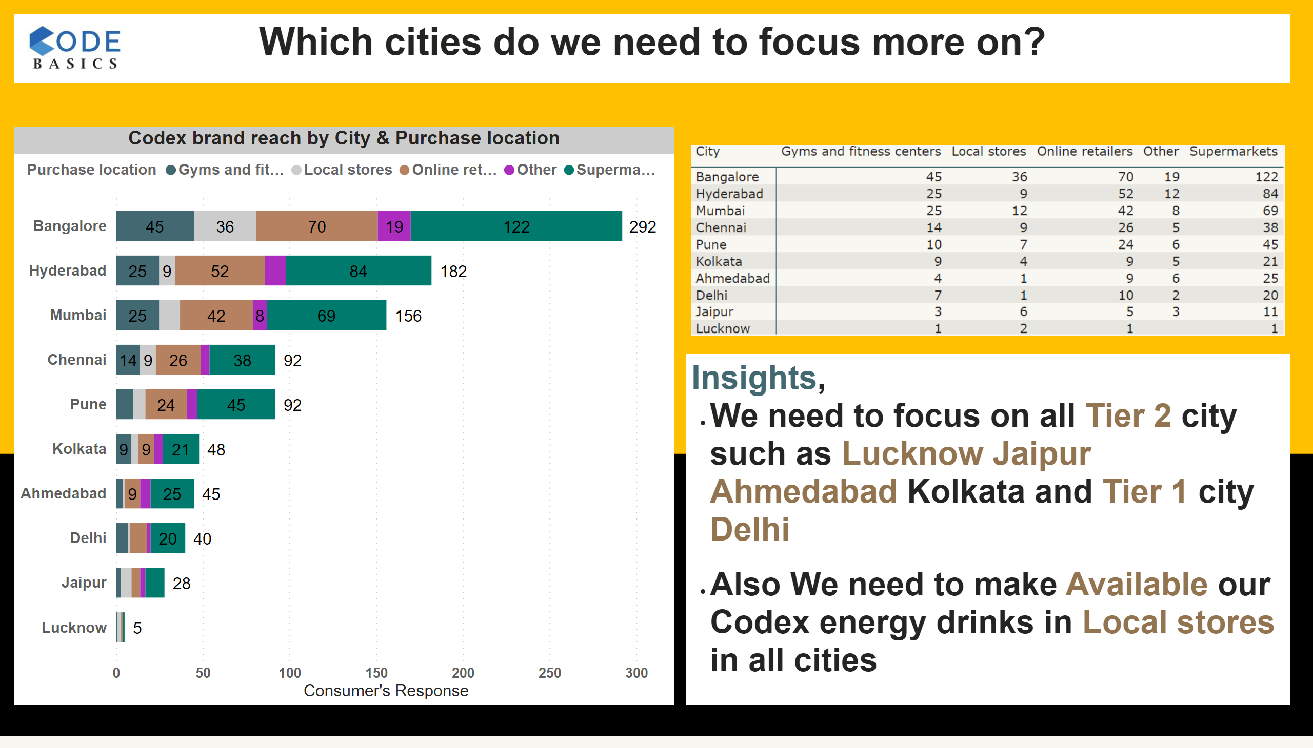
5.2
Notes:
Codex brand reach by City & Purchase location
No alt text provided
image
No alt text provided
textbox
No alt text provided
textbox
No alt text provided
image
No alt text provided

Slide 18
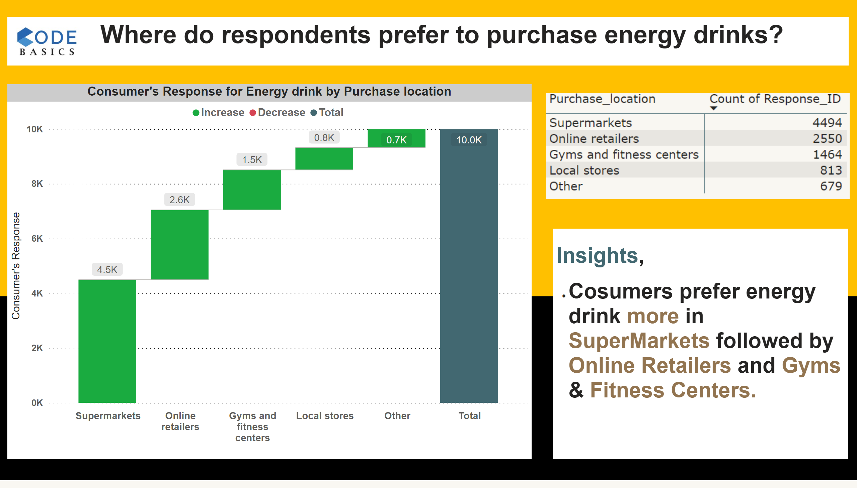
6.1
Notes:
Consumer's Response for Energy drink by Purchase location
No alt text provided
image
No alt text provided
textbox
No alt text provided
textbox
No alt text provided
image
No alt text provided

Slide 19
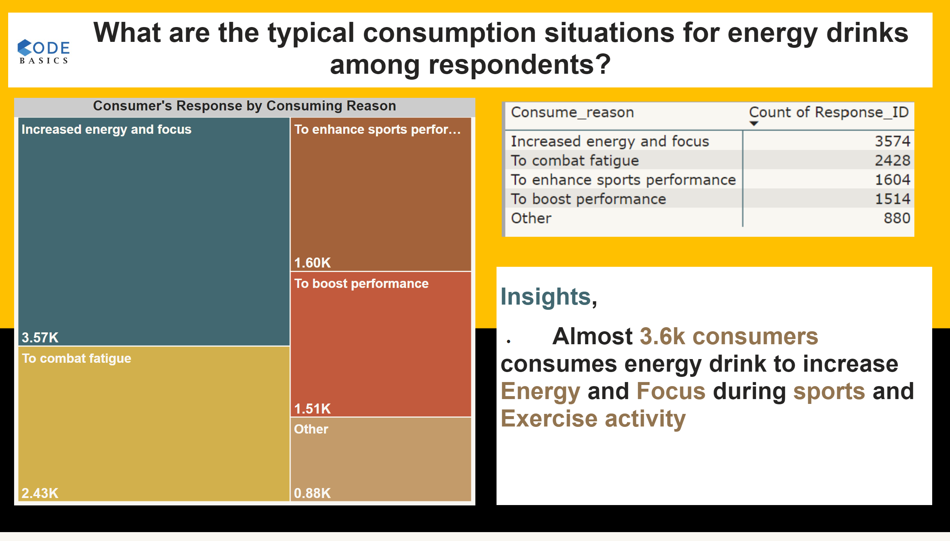
6.2
Notes:
Consumer's Response by Consuming Reason
No alt text provided
image
No alt text provided
textbox
No alt text provided
textbox
No alt text provided
image
No alt text provided

Slide 20
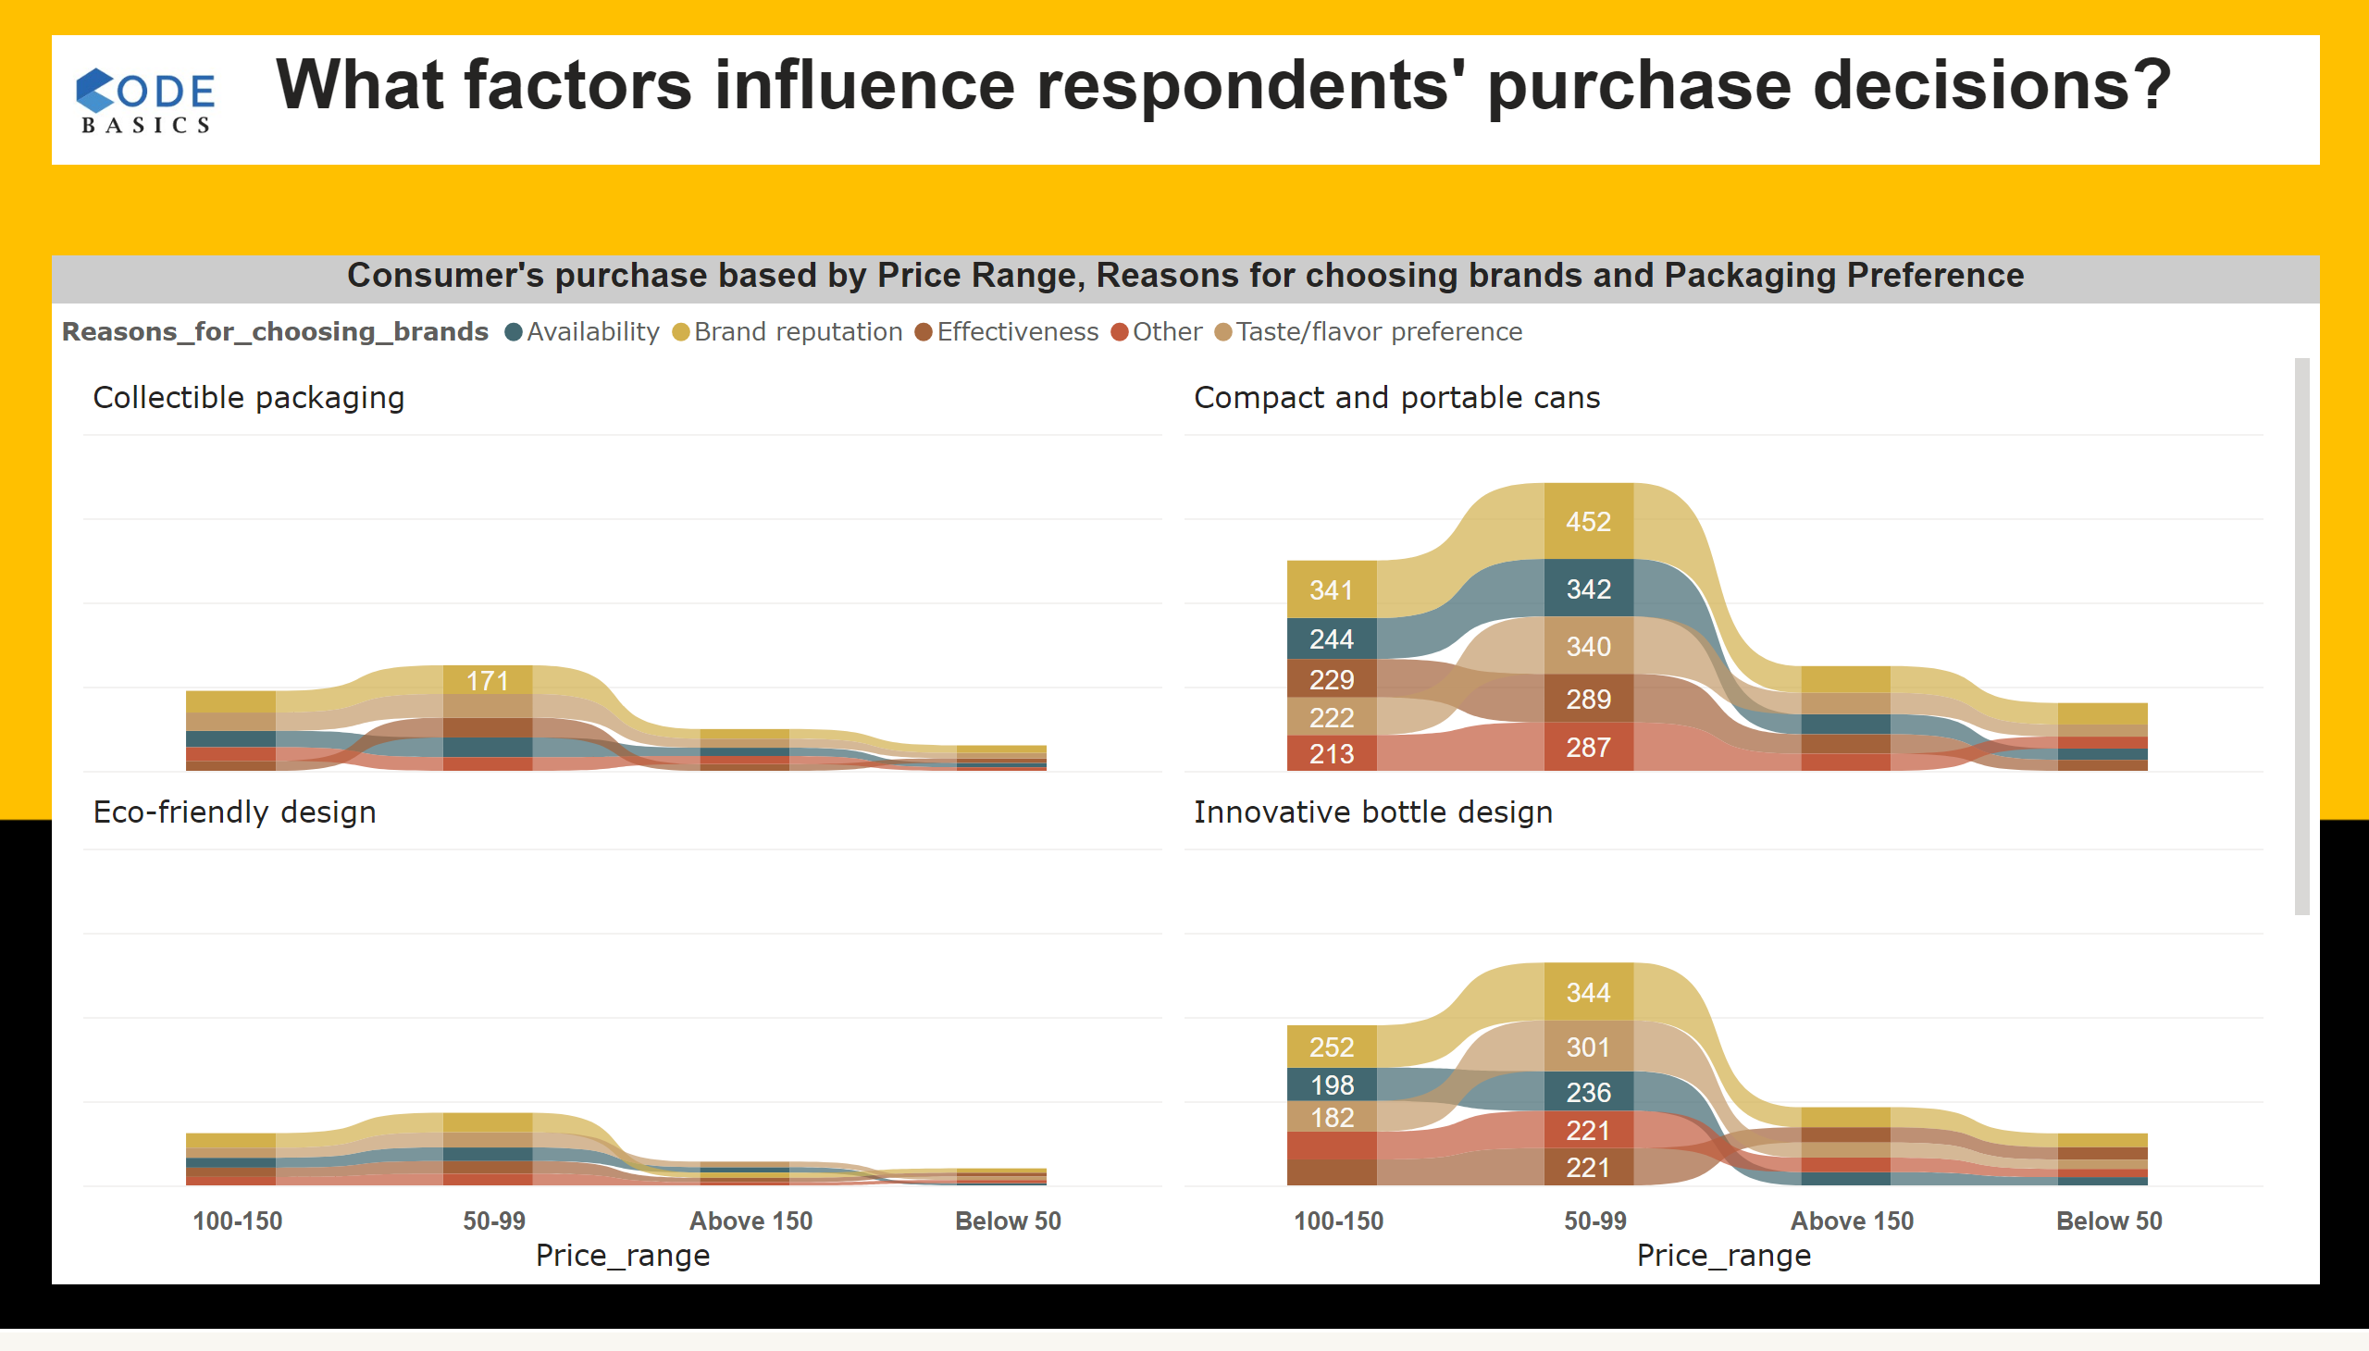
6.3
Notes:
Consumer's purchase based by Price Range, Reasons for choosing brands and Packaging Preference
No alt text provided
textbox
No alt text provided
image
No alt text provided

Slide 21
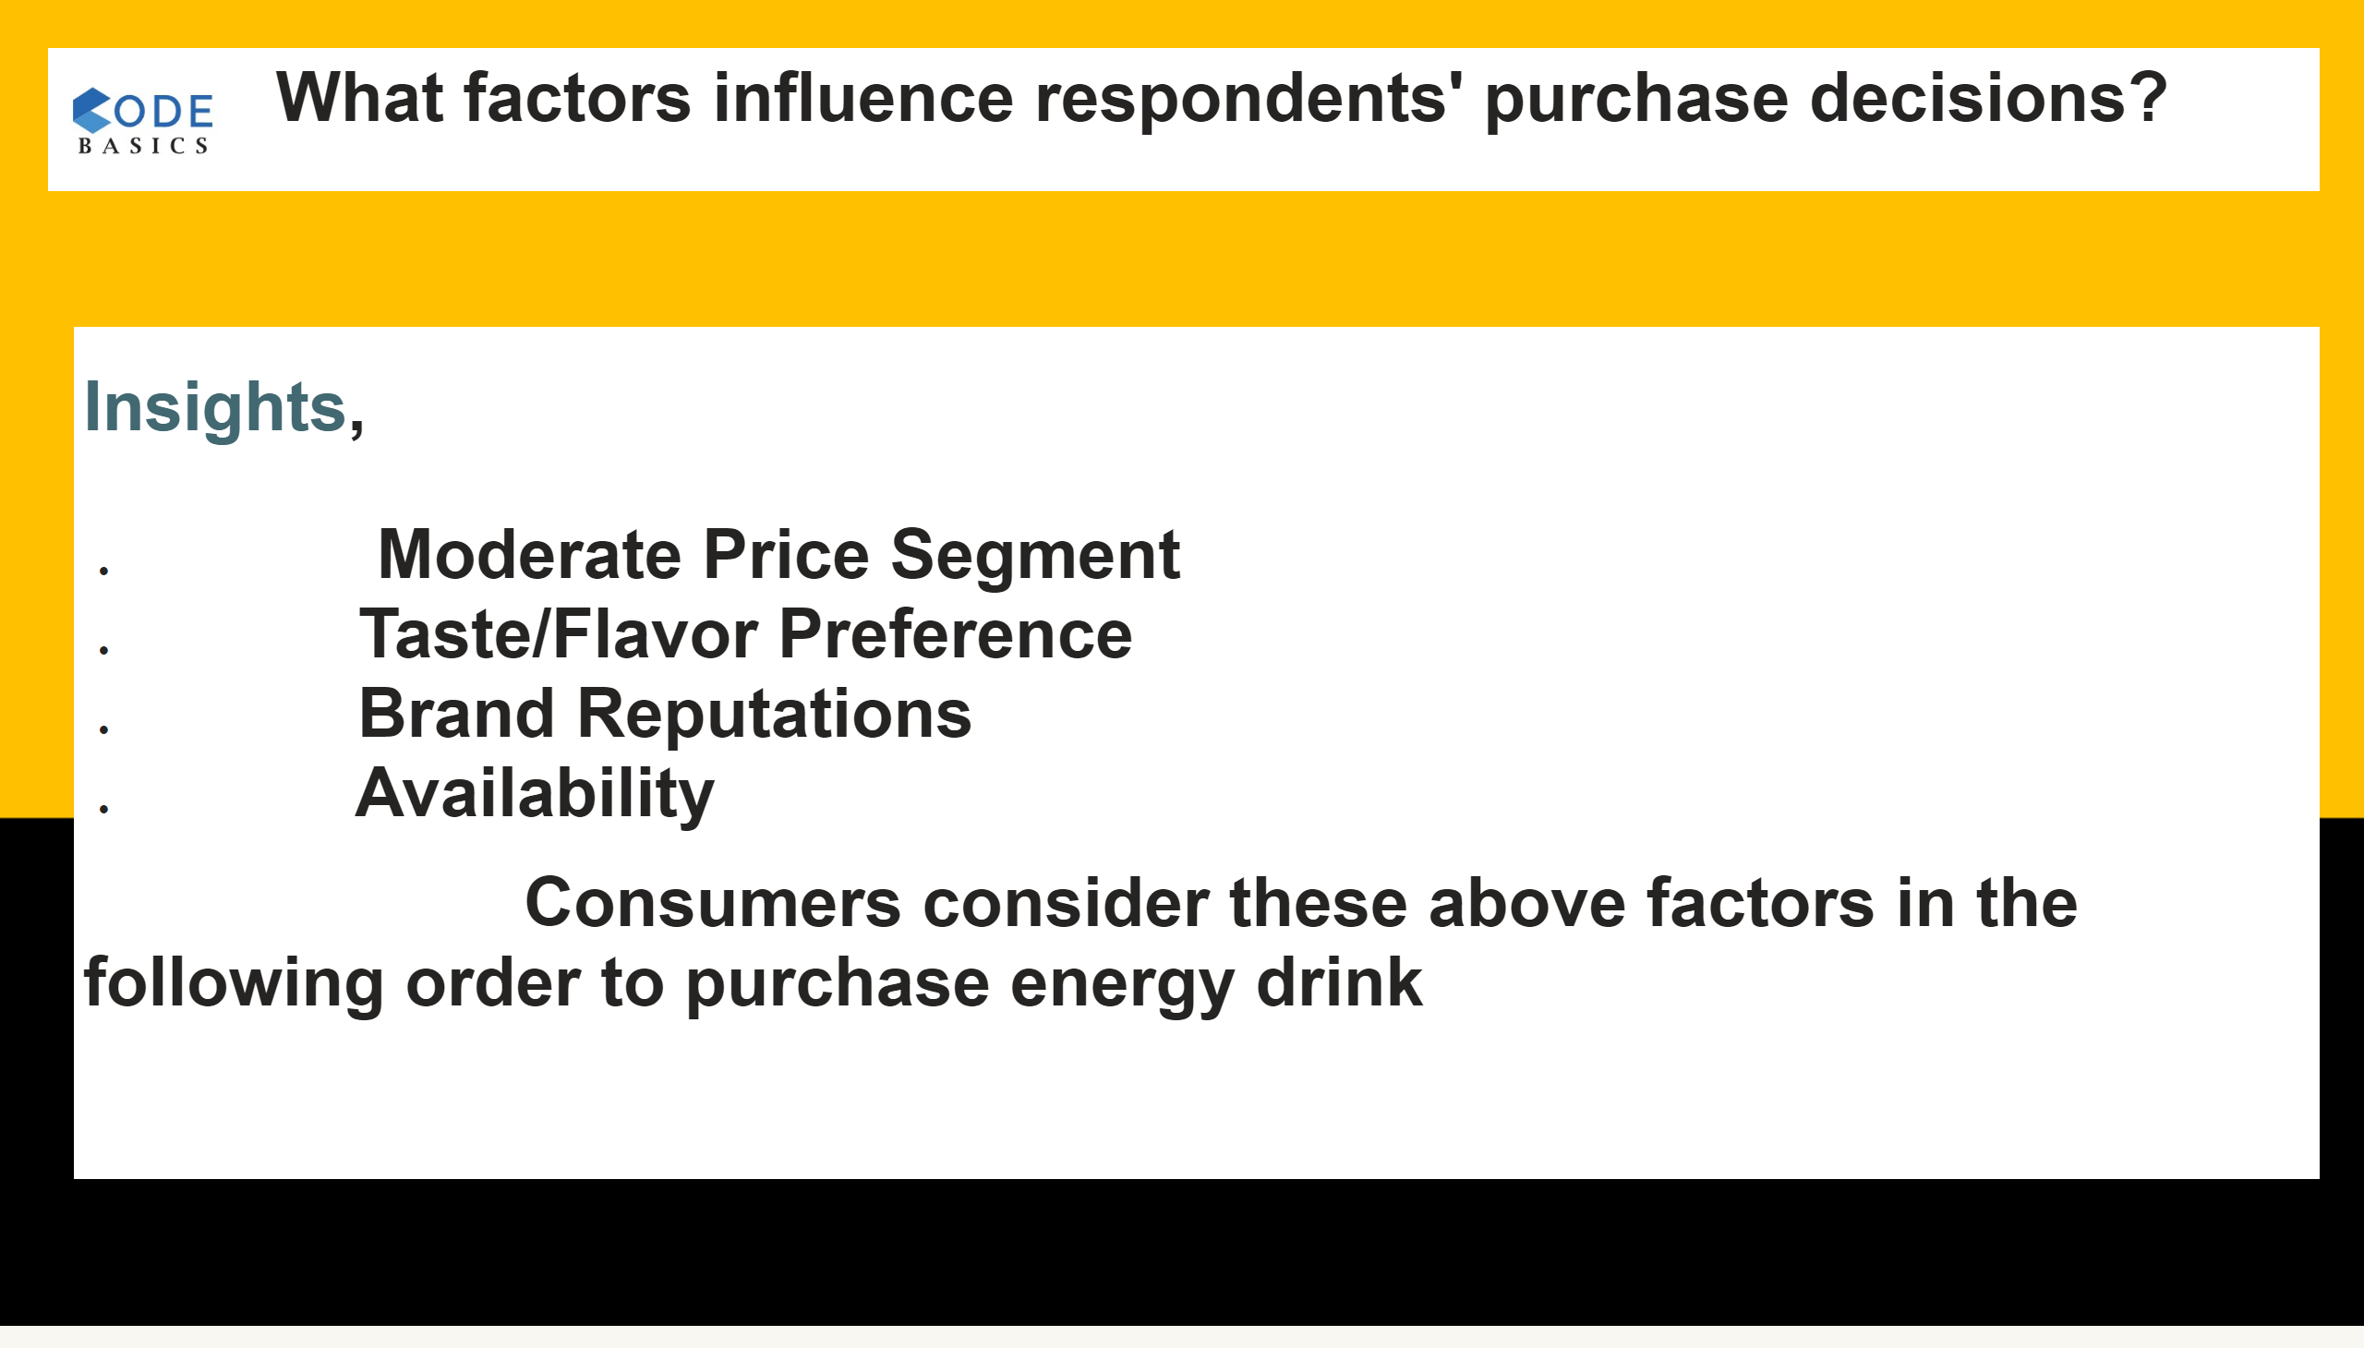
6.4
Notes:
textbox
No alt text provided
textbox
No alt text provided
image
No alt text provided

Slide 22
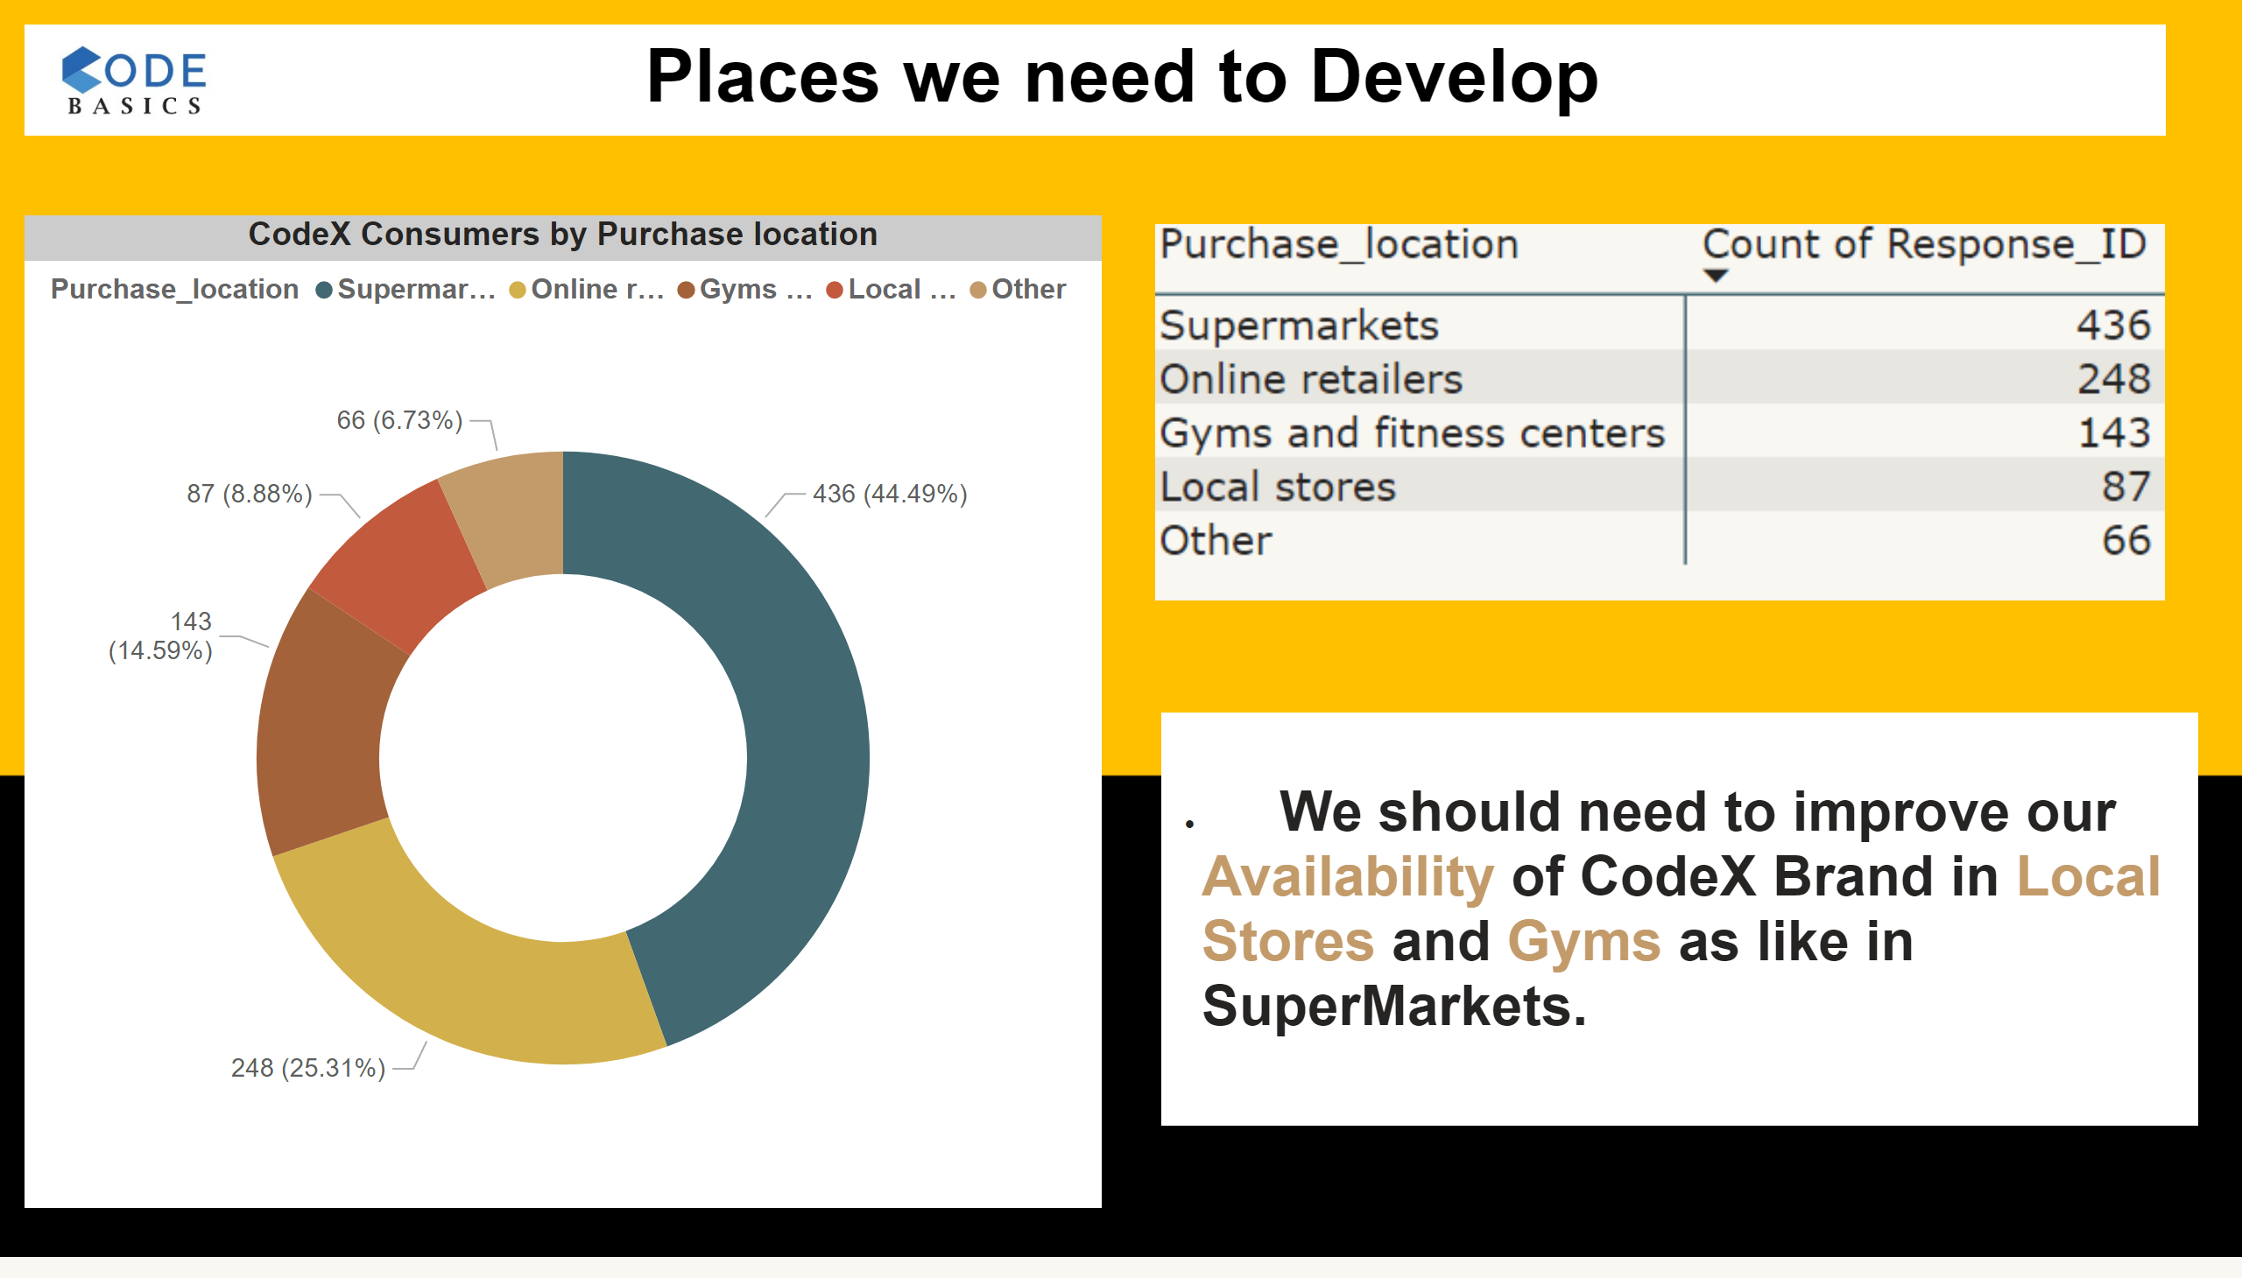
7.1
Notes:
CodeX Consumers by Purchase location
No alt text provided
image
No alt text provided
textbox
No alt text provided
textbox
No alt text provided
image
No alt text provided

Slide 23
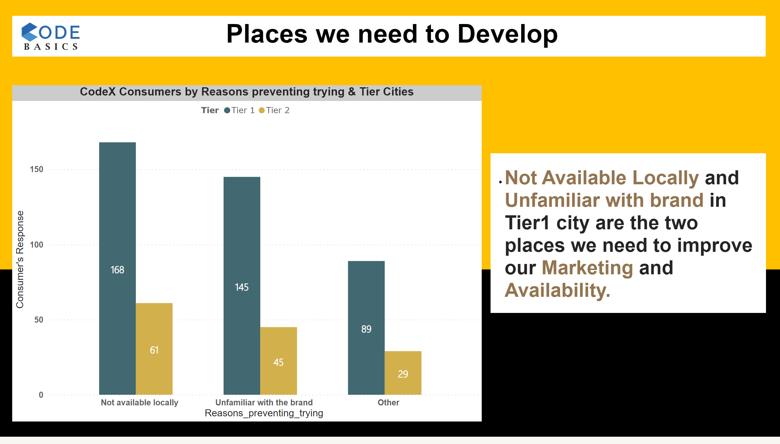
7.2
Notes:
CodeX Consumers by Reasons preventing trying & Tier Cities
No alt text provided
textbox
No alt text provided
textbox
No alt text provided
image
No alt text provided

Slide 24
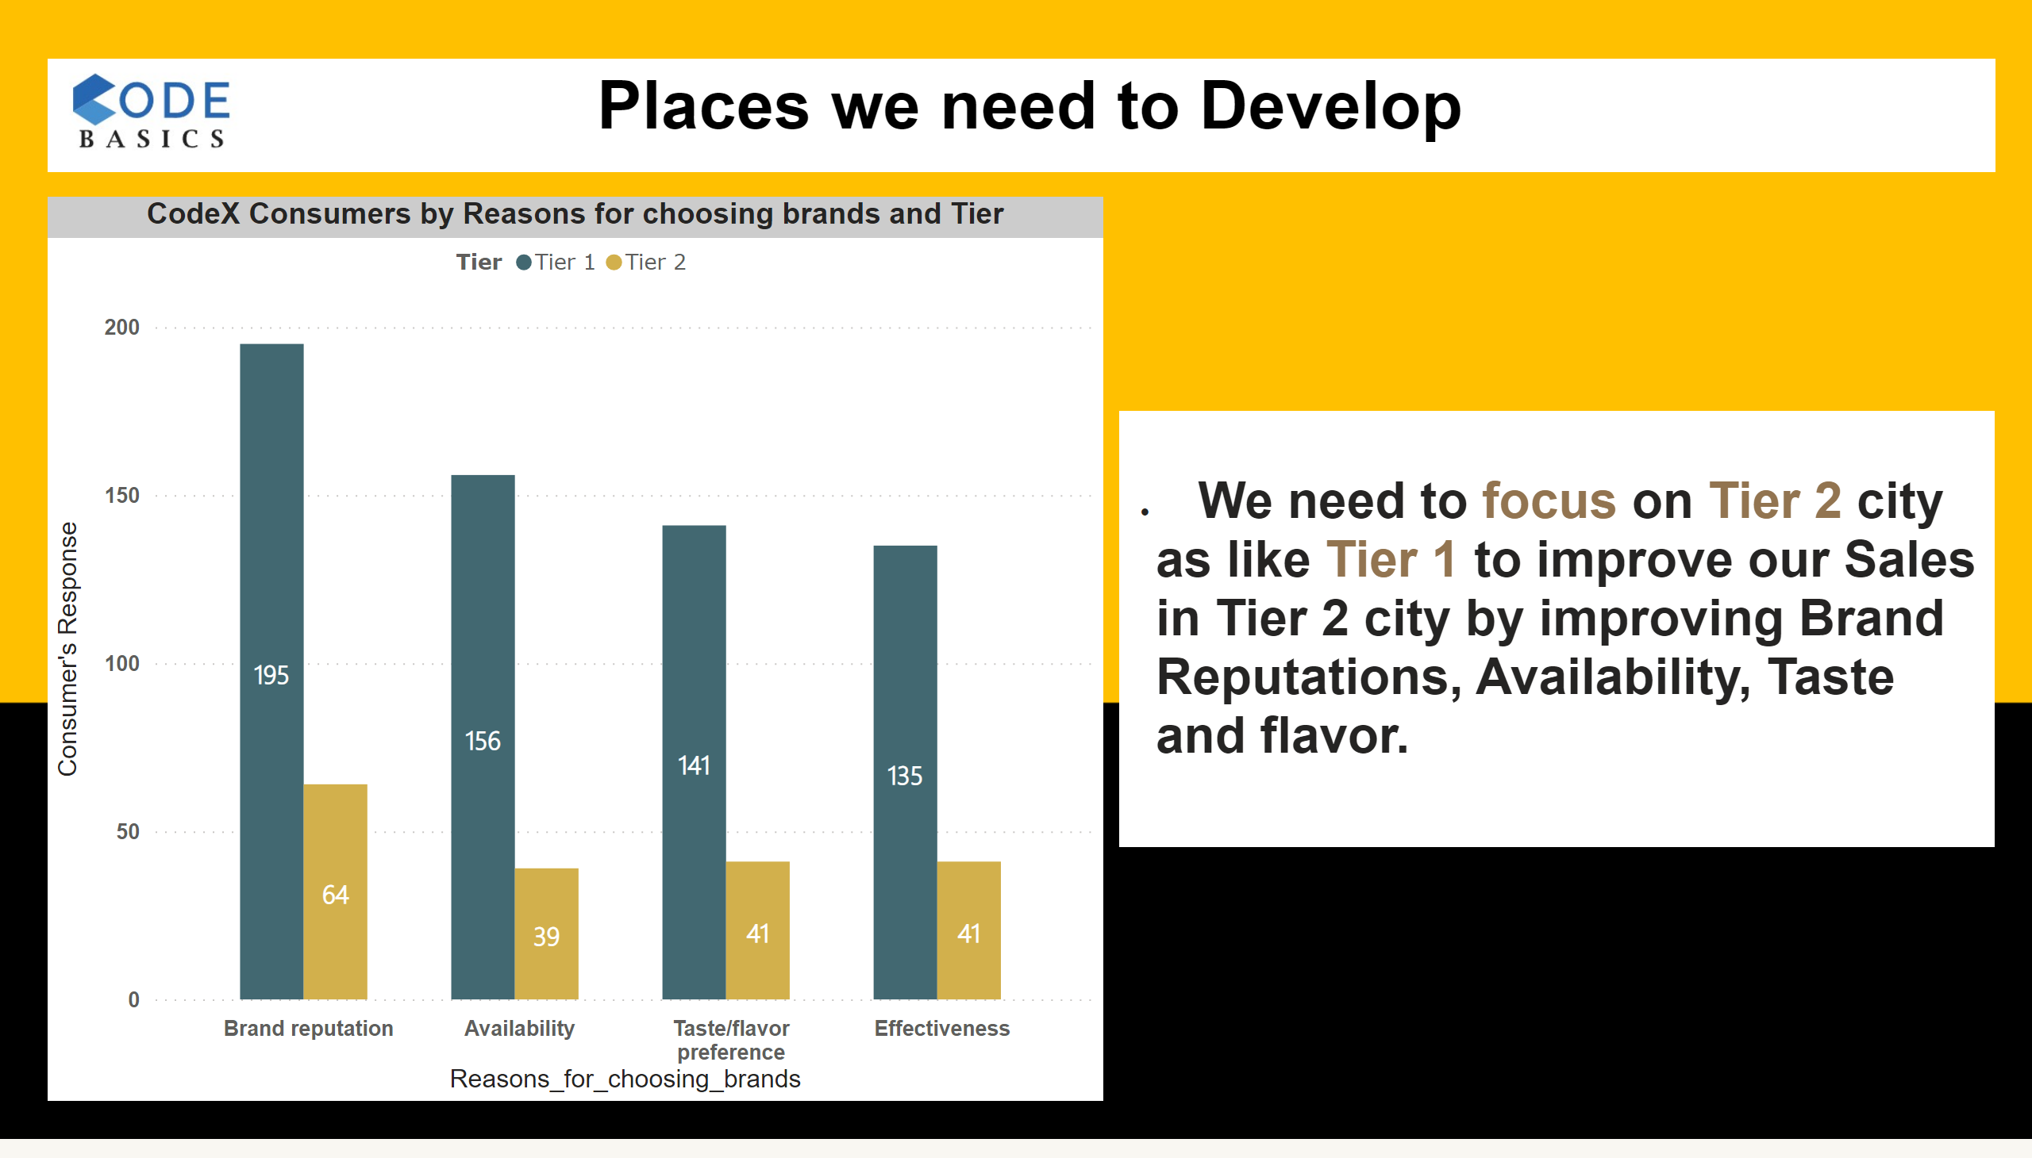
7.3
Notes:
CodeX Consumers by Reasons for choosing brands and Tier
No alt text provided
textbox
No alt text provided
textbox
No alt text provided
image
No alt text provided

Slide 25
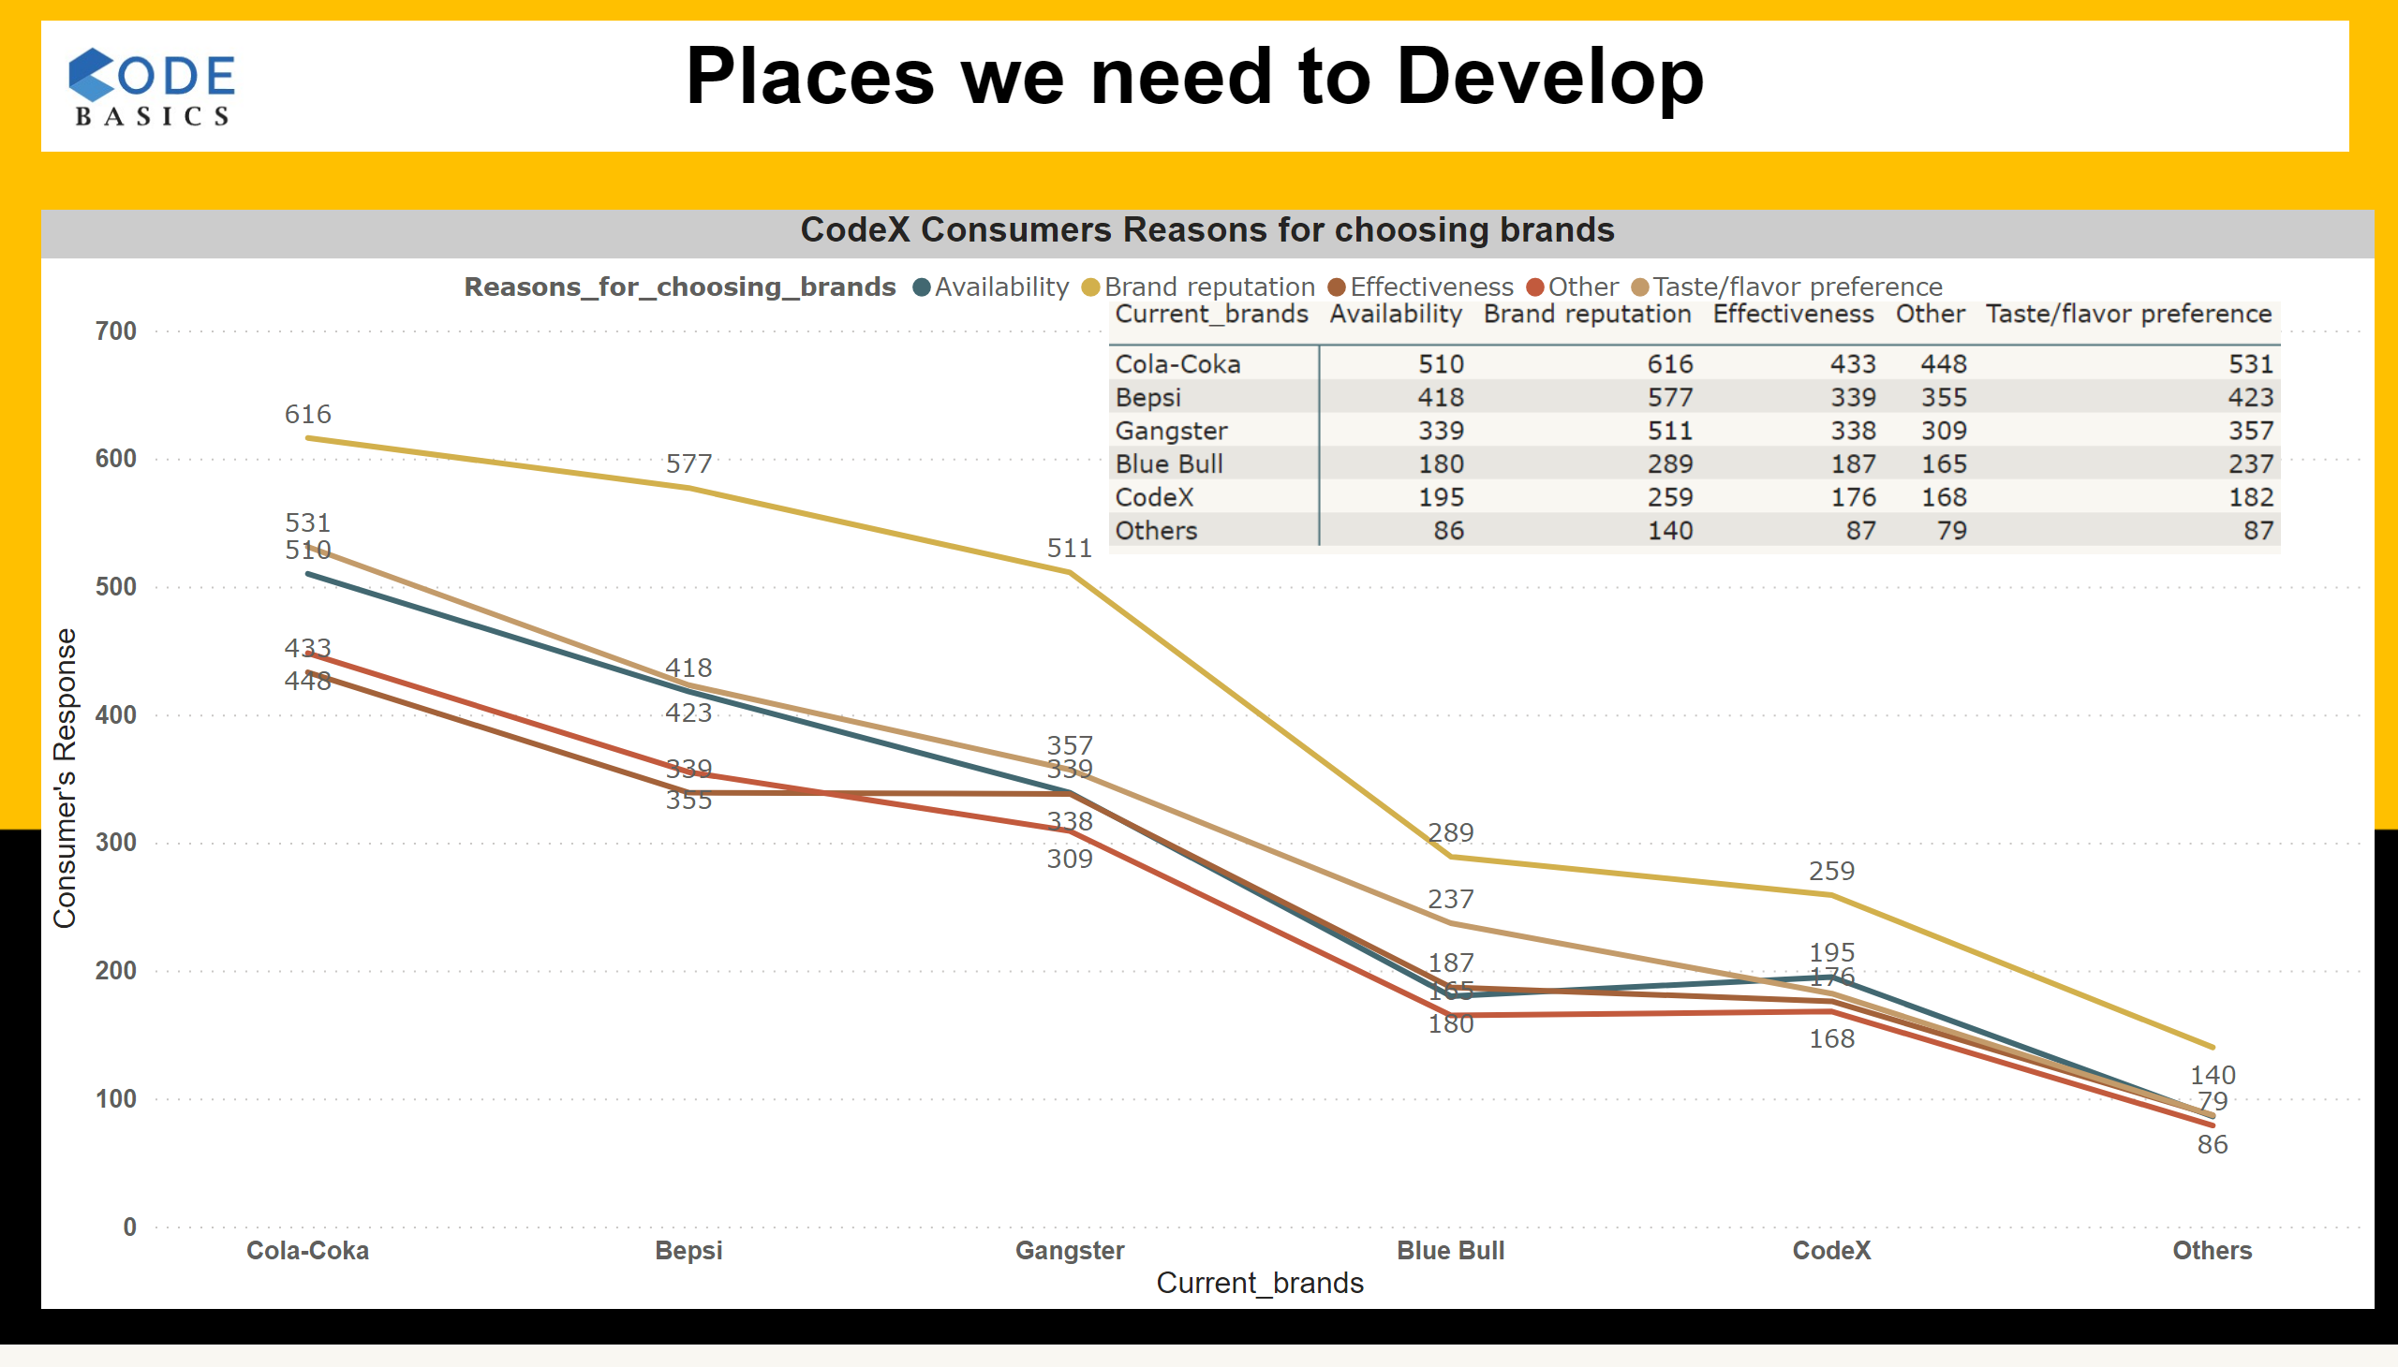
7.4
Notes:
CodeX Consumers Reasons for choosing brands
No alt text provided
image
No alt text provided
textbox
No alt text provided
image
No alt text provided

Slide 26
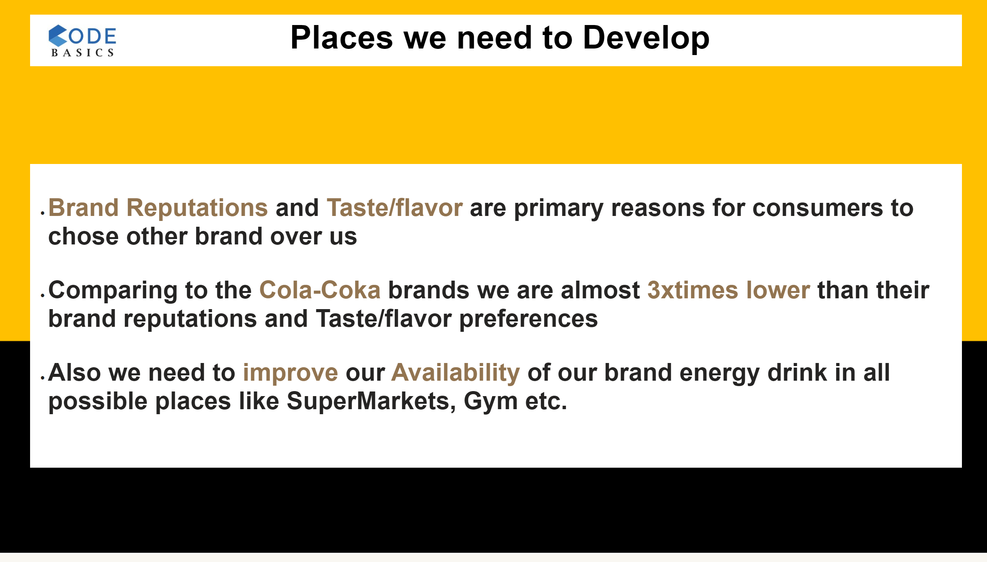
7.5
Notes:
textbox
No alt text provided
textbox
No alt text provided
image
No alt text provided

Slide 27
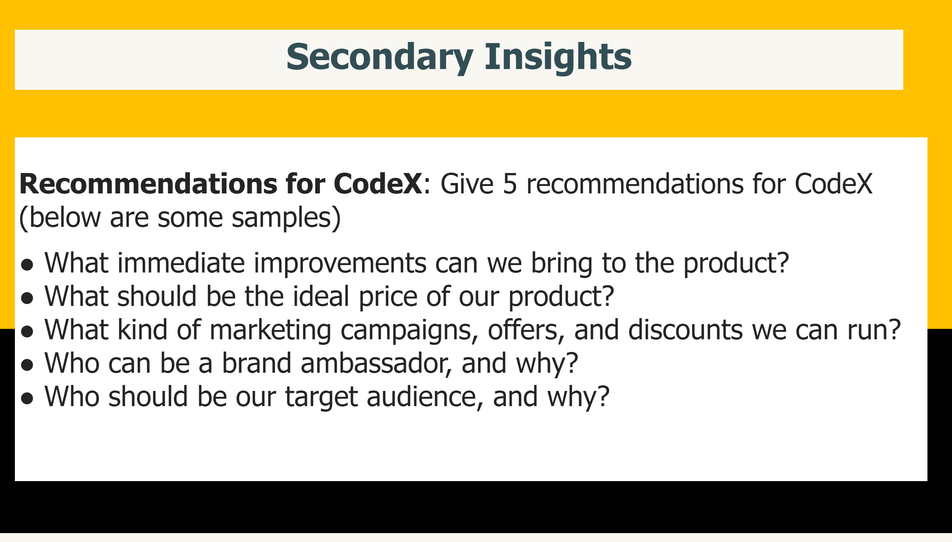
8
Notes:
textbox
No alt text provided
textbox
No alt text provided

Slide 28
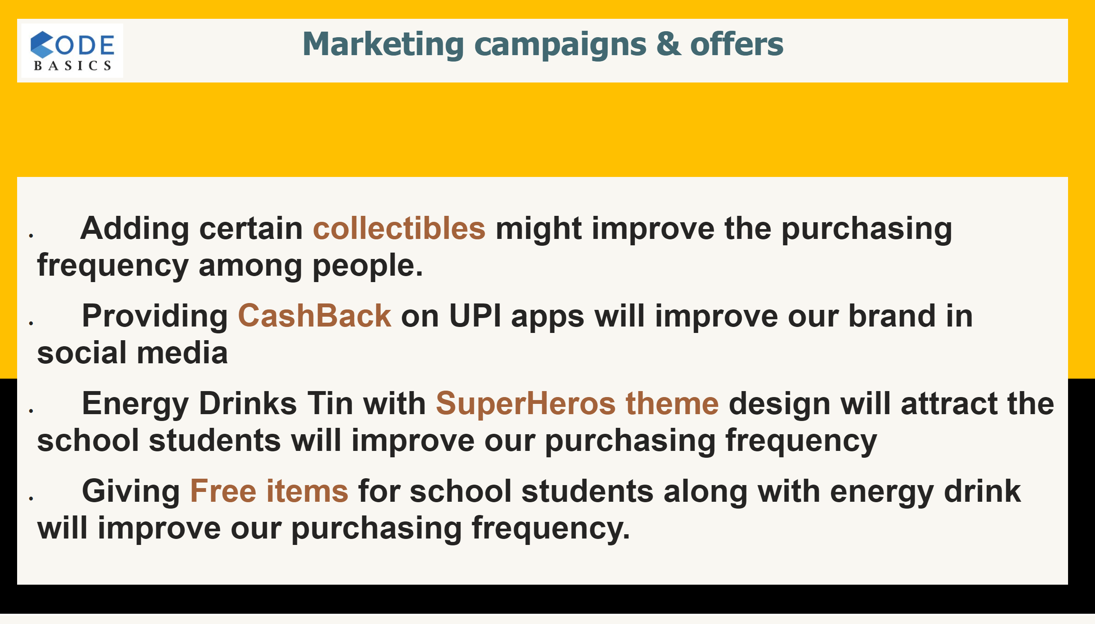
8.1
Notes:
textbox
No alt text provided
textbox
No alt text provided
image
No alt text provided

Slide 29
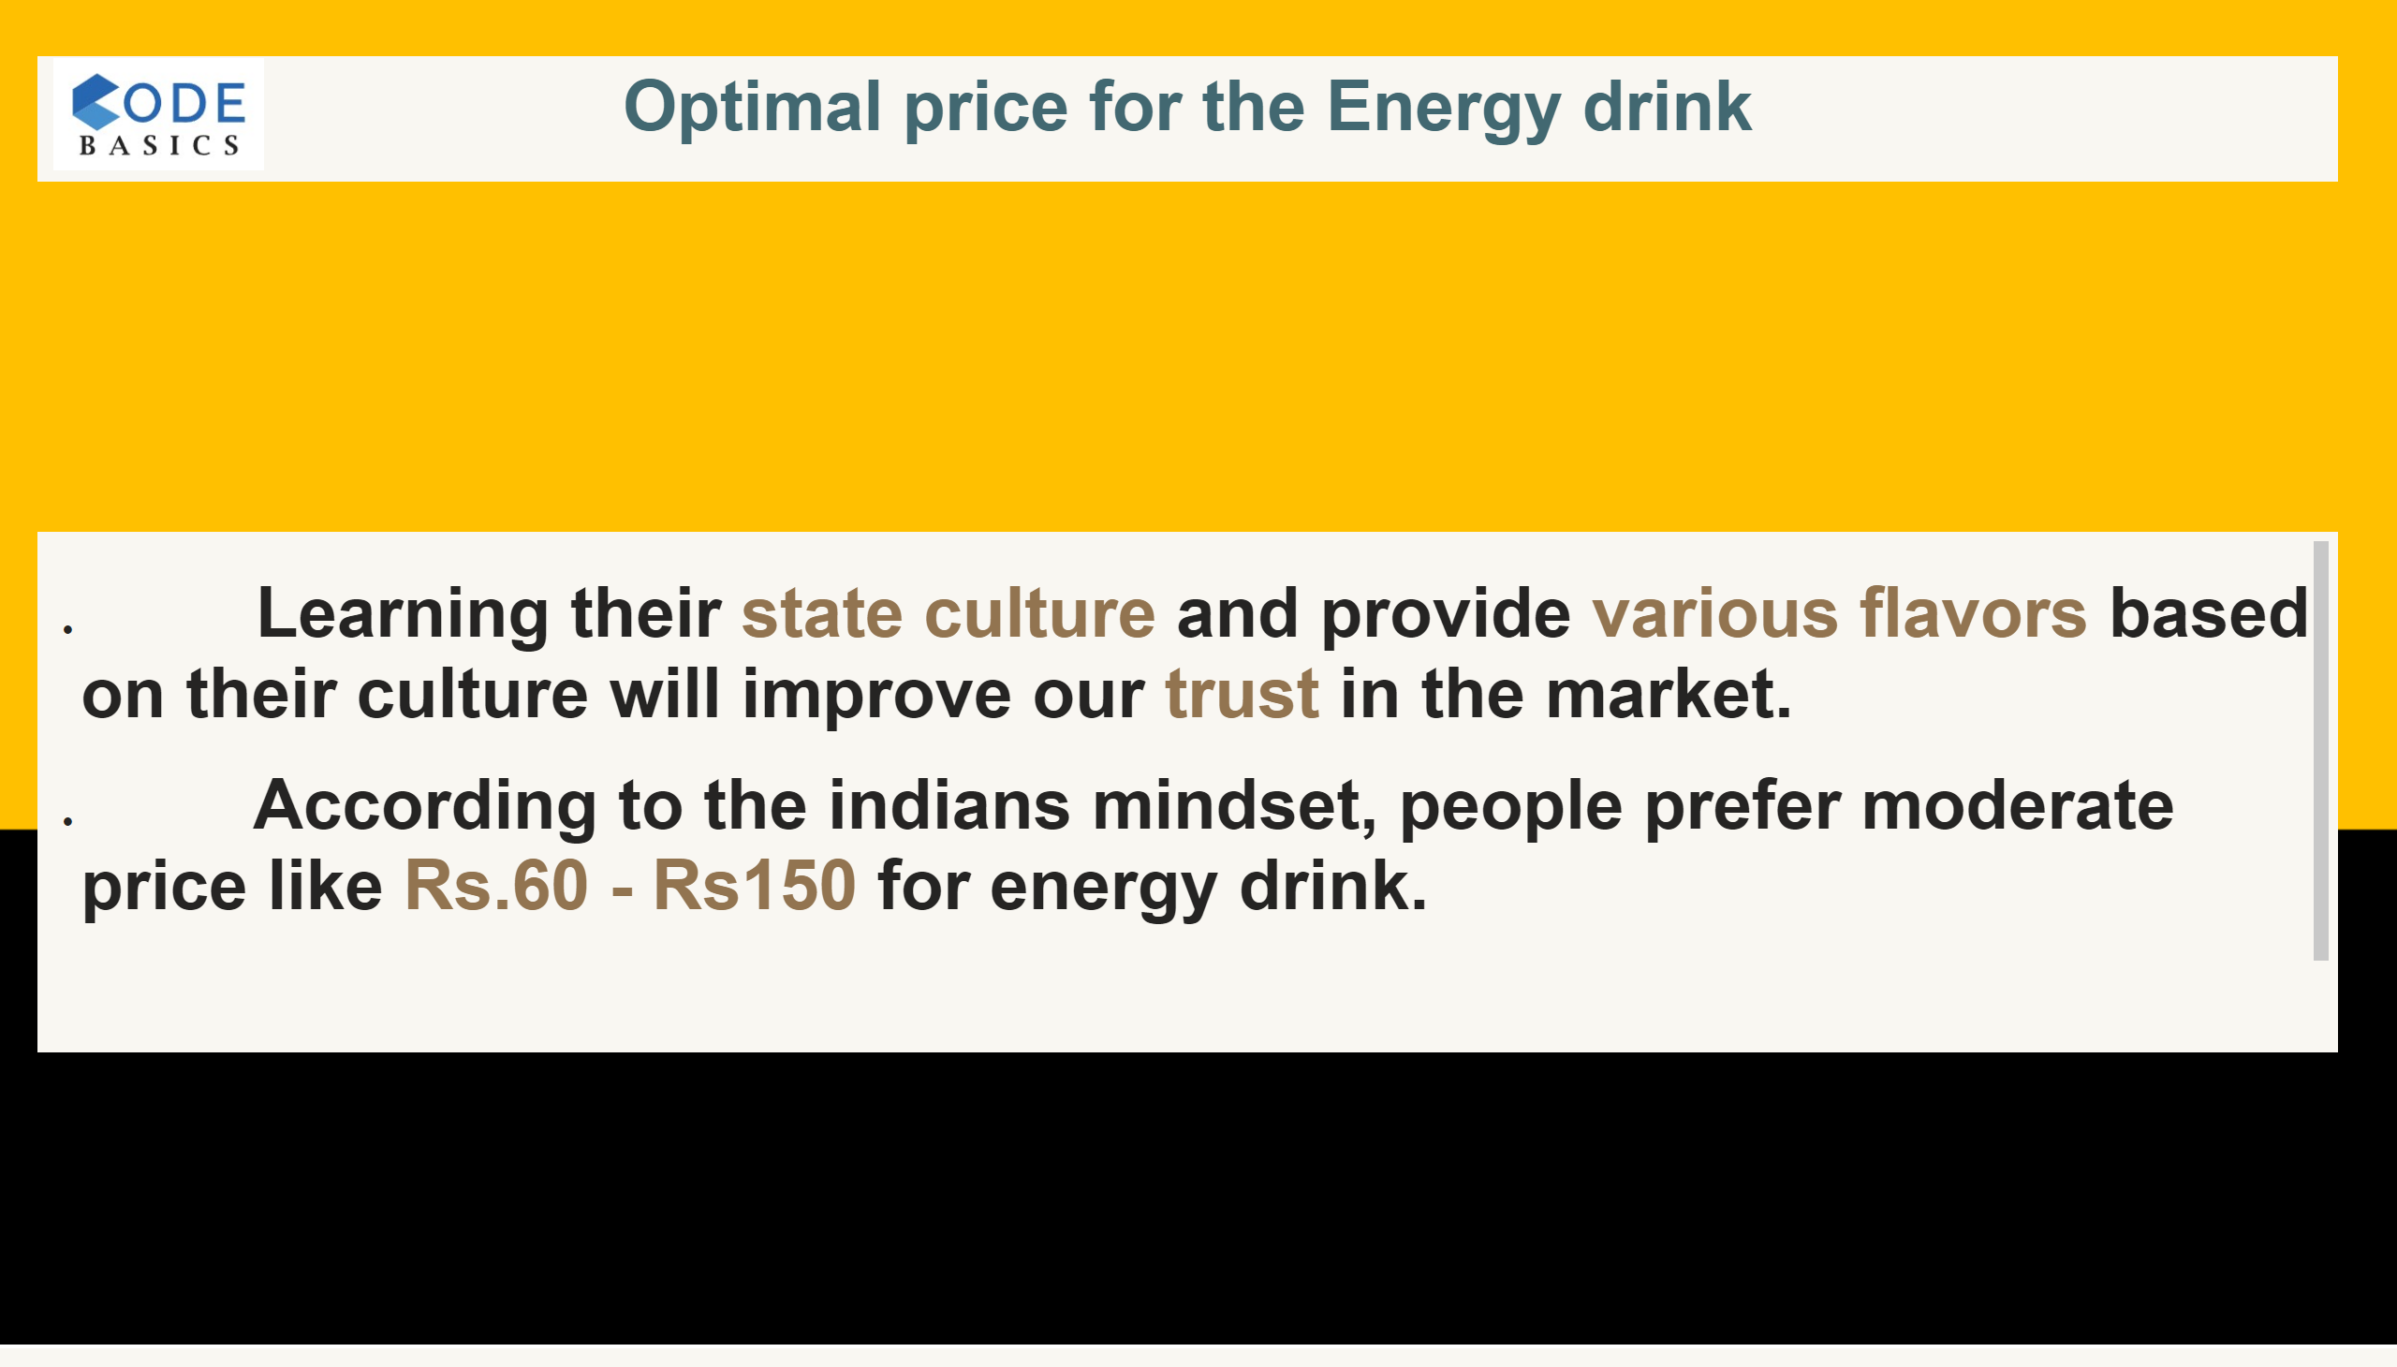
8.2
Notes:
textbox
No alt text provided
textbox
No alt text provided
image
No alt text provided

Slide 30
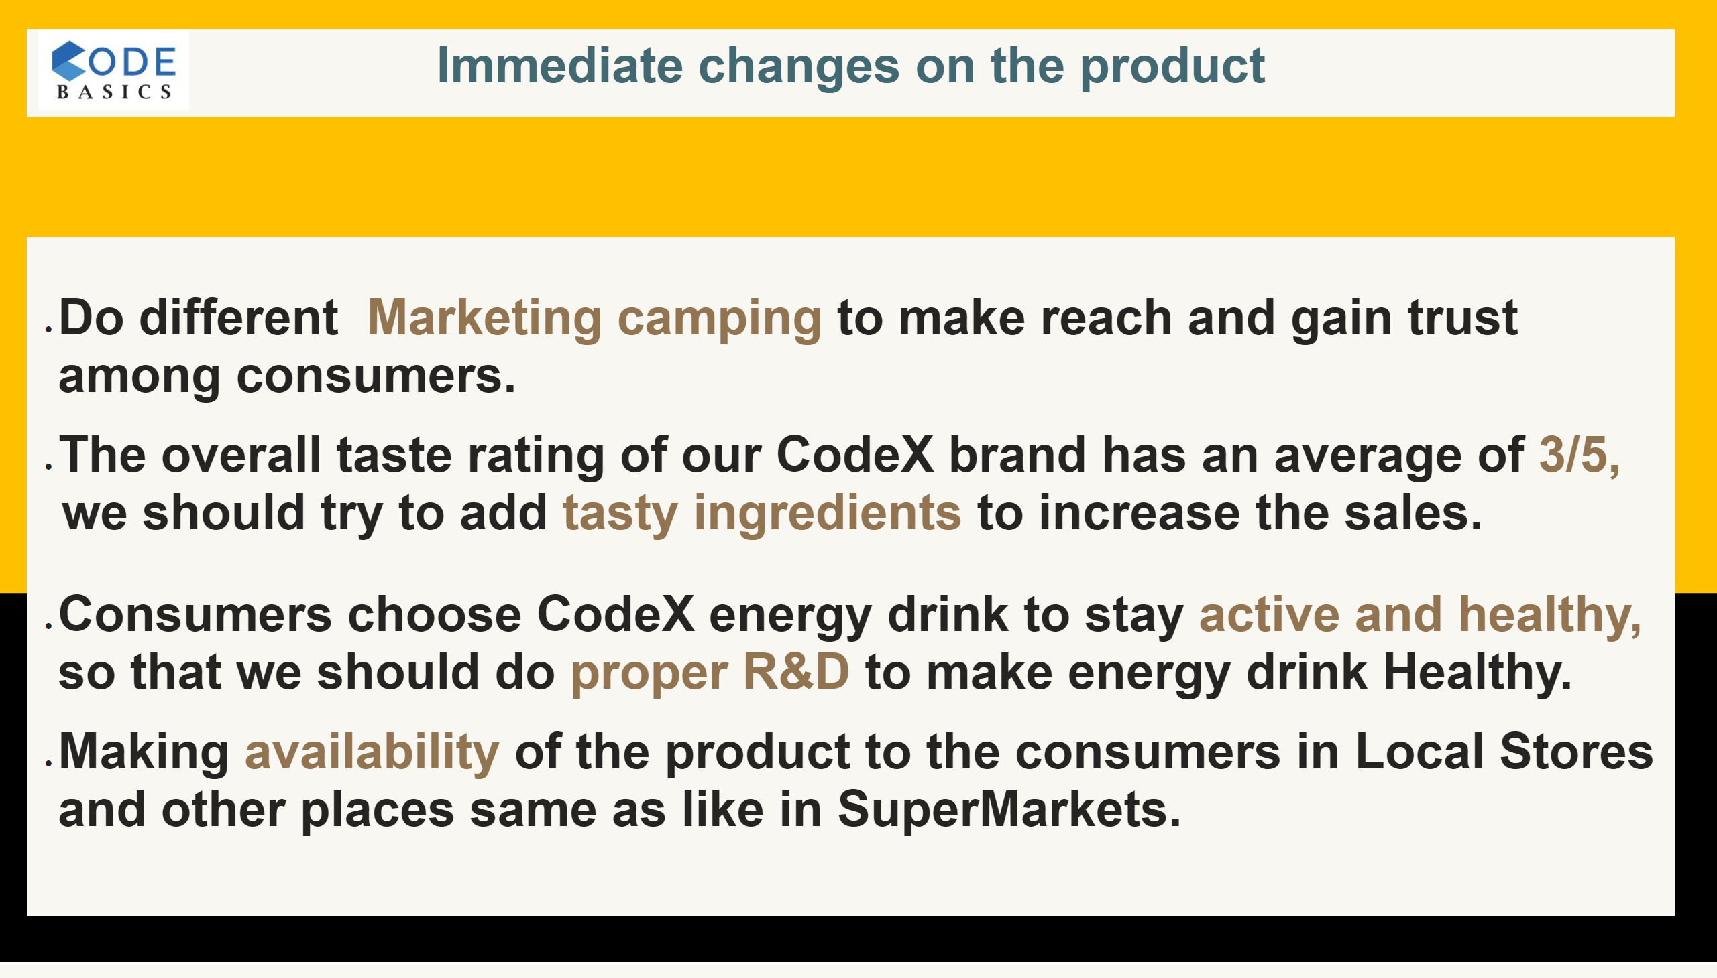
8.3
Notes:
textbox
No alt text provided
textbox
No alt text provided
image
No alt text provided

Slide 31
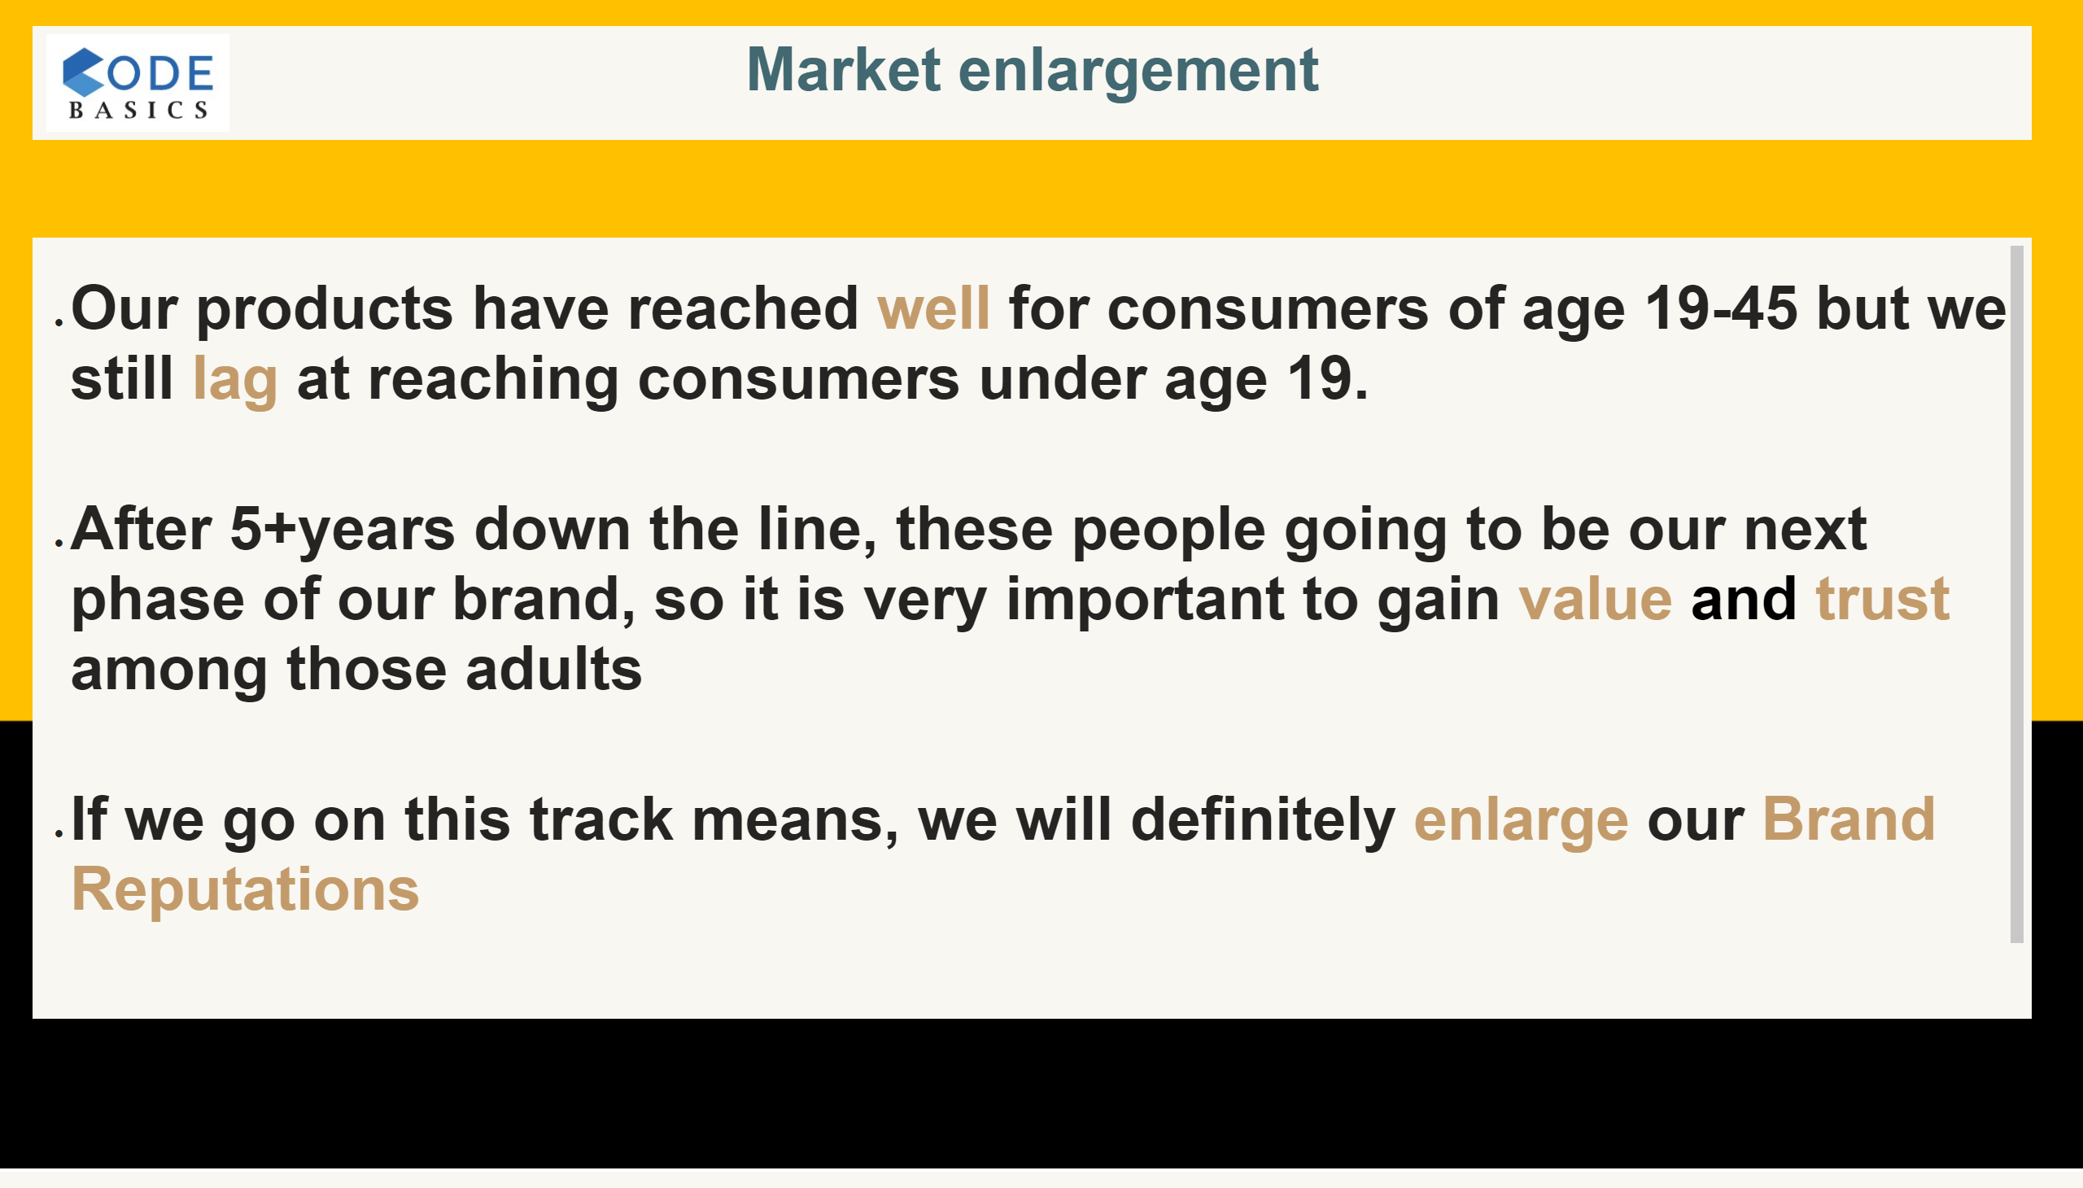
8.4
Notes:
textbox
No alt text provided
textbox
No alt text provided
image
No alt text provided

Slide 32

8.5
Notes:
textbox
No alt text provided
textbox
No alt text provided
image
No alt text provided

Slide 33
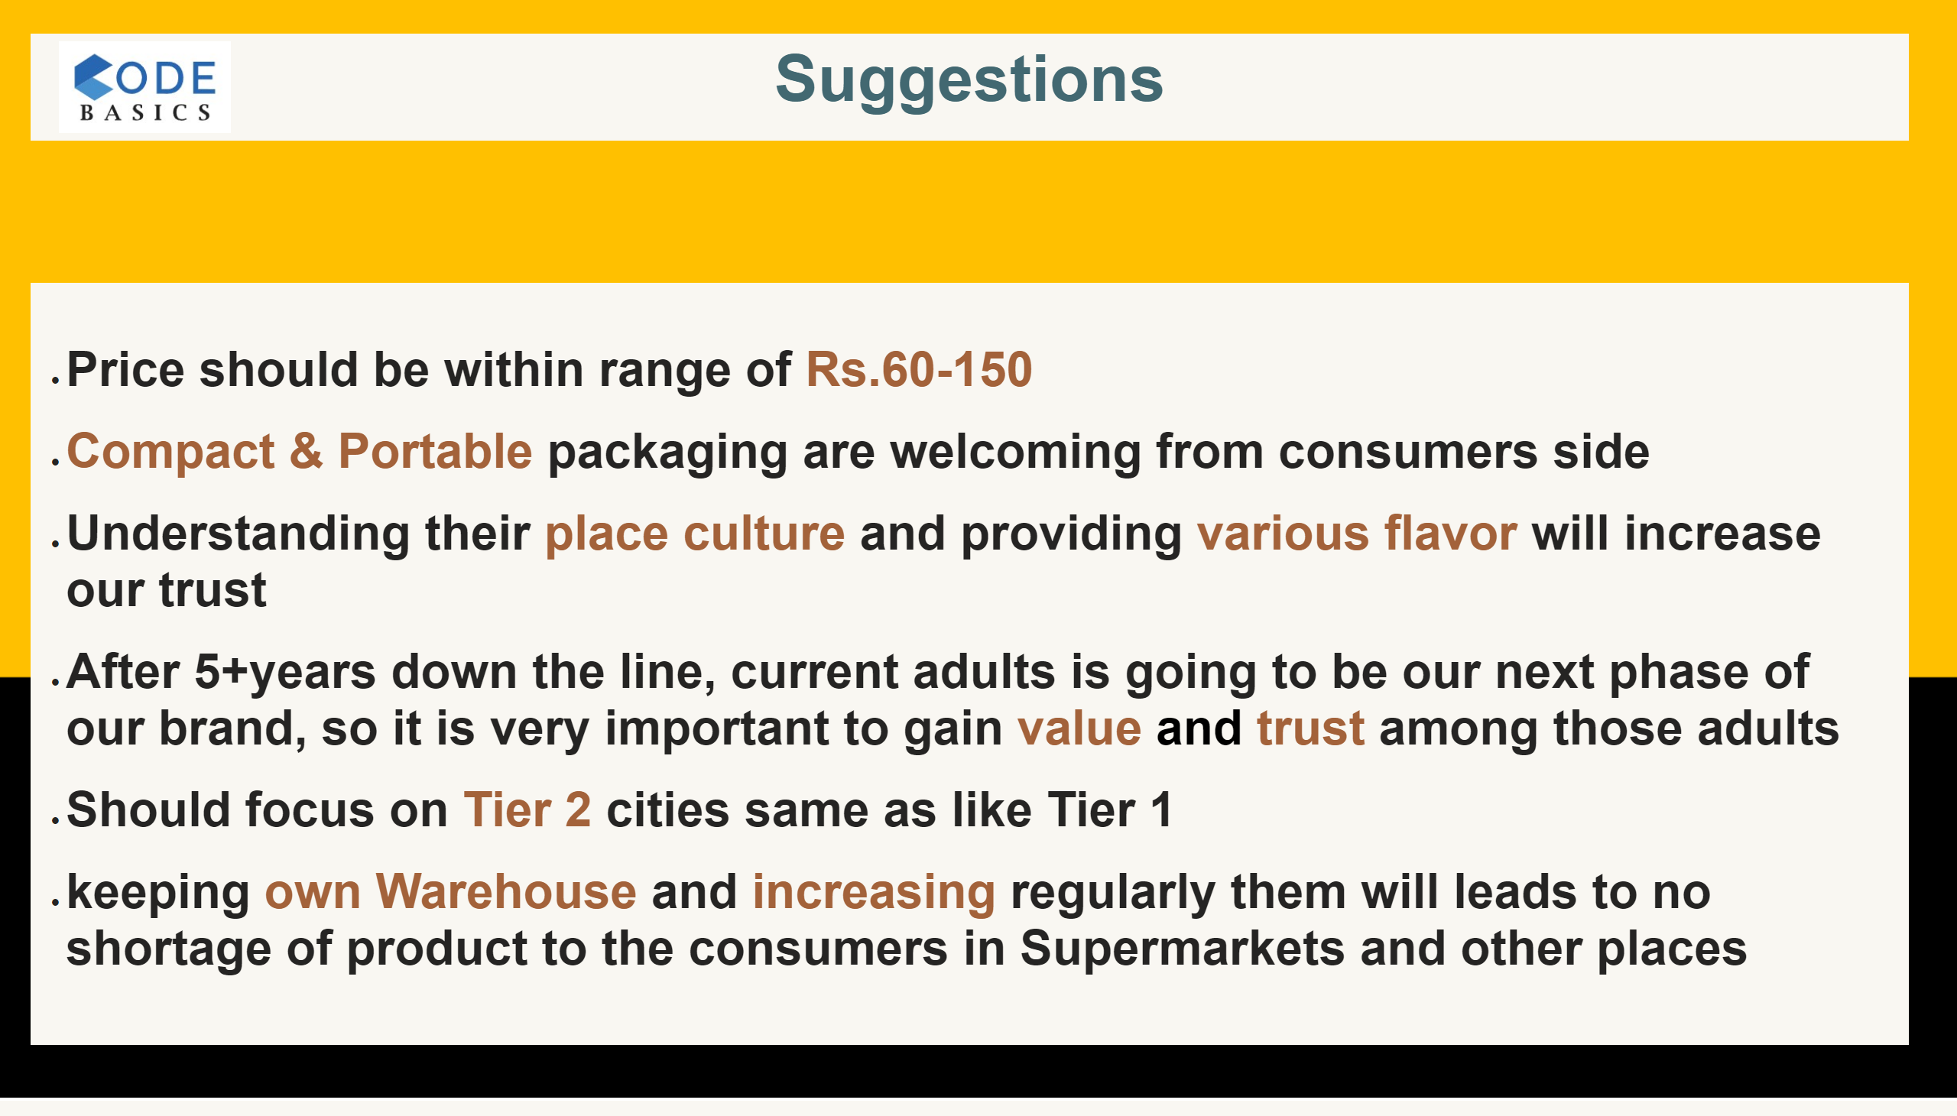
Suggestions
Notes:
textbox
No alt text provided
textbox
No alt text provided
image
No alt text provided

Slide 34
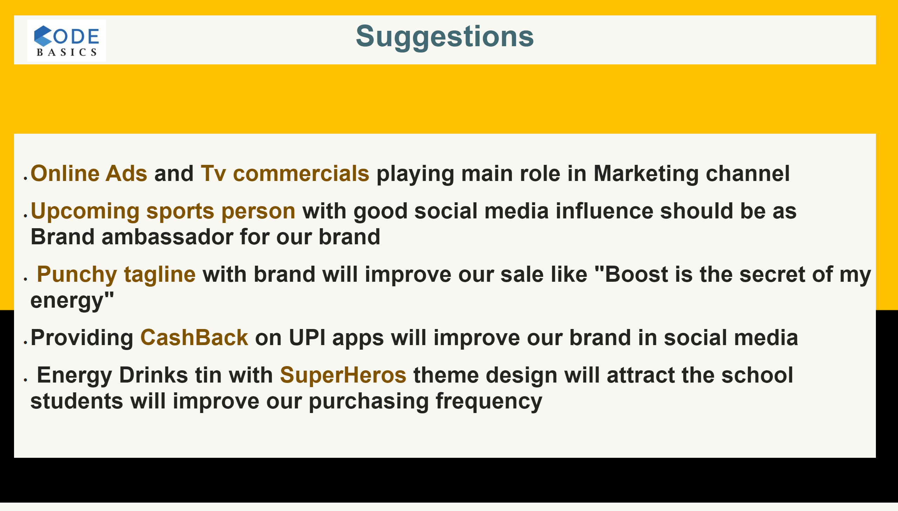
Suggestions
Notes:
textbox
No alt text provided
textbox
No alt text provided
image
No alt text provided

Slide 35

Thanksnote
Notes:
textbox
No alt text provided
image
No alt text provided
textbox
No alt text provided
image
No alt text provided

